Slide 1
Module 4: Secure Device Access
Instructor Materials
Networking Security v1.0
(NETSEC)
Notes:
Networking Security (NETSEC) Module 4: Secure Device Access

Slide 2
Module Objectives
Module Title: Secure Device Access
Module Objective: Configure secure administrative devices.
Topic Title | Topic Objective
Securing the Edge Router | Explain how to secure a network perimeter.
Configure Secure Administrative Access | Use the correct commands to configure passwords on a Cisco IOS device.
Configure Enhanced Security for Virtual Logins | Use the correct commands to configure enhanced security for virtual logins.
Configure SSH | Configure an SSH daemon for secure remote management.
Notes:
2
4 – Secure Device Access
4.0.2 – What will I learn to do in this module?

Slide 3
4.1 Secure the Edge Router
Notes:
4: Secure Device Access 4.1: Secure the Edge Router

Slide 4
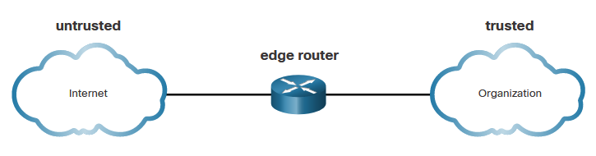
Secure the Edge Router
Secure the Network Infrastructure
Securing the network infrastructure is critical to overall network security. The network infrastructure includes routers, switches, servers, endpoints, and other devices. Routers are a primary target for attacks because these devices direct traffic into, out of, and between networks.
The edge router shown in the figure is the last router between the internal network and an untrusted network, such as the internet. All an organization’s internet traffic goes through an edge router, which often functions as the first and last line of defense for a network.
Notes:
4: Secure Device Access 4.1: Secure the Edge Router 4.1.1: Secure the Network Infrastructure

Slide 5
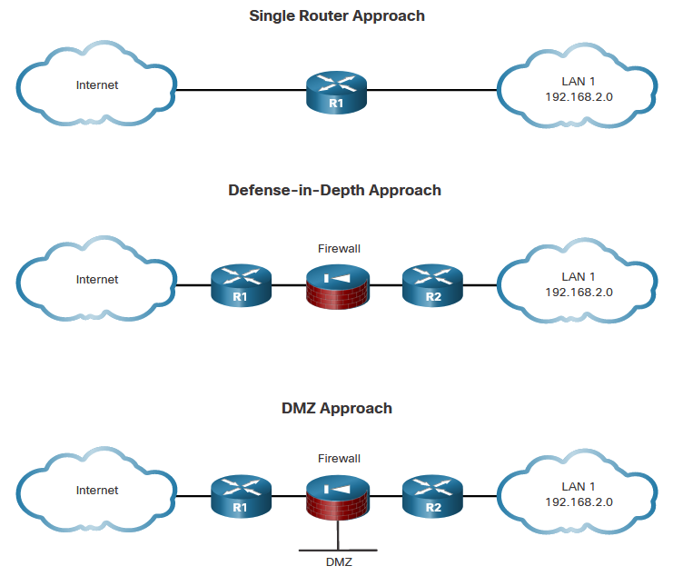
Secure the Edge Router
Edge Router Security Approaches
Single Router - A single router connects the protected network or internal local area network (LAN), to the internet. All security policies are configured on this device.
Defense-in-Depth – This uses multiple layers of security prior to traffic entering the protected LAN. There are three primary layers of defense: the edge router, the firewall, and an internal router that connects to the protected LAN.
DMZ - The DMZ can be used for servers that must be accessible from the internet or another external network. The DMZ can be set up between two routers, with an internal router connecting to the protected network and an external router connecting to the unprotected network.
Notes:
4: Secure Device Access 4.1: Secure the Edge Router 4.1.2: Edge Router Security Approaches

Slide 6
Secure the Edge Router
Three Areas of Router Security
Three areas of router security must be maintained:
Physical - Place the router and physical devices that connect to it in a secure locked room that is accessible only to authorized personnel. Install an uninterruptible power supply (UPS) or diesel backup power generator.
Operating System - Configure the router with the maximum amount of memory possible. The availability of memory can help mitigate DoS attacks. Use the latest, stable version of the operating system that meets the feature specifications of the router or network device. Keep a secure copy of router operating system images and router configuration files as backups.
Router Hardening - Ensure that only authorized personnel have access and that their level of access is controlled. Disable unused ports and interfaces. Disable unnecessary services. A router has services that are enabled by default. Some of these services can be used by an attacker to gather information about the router and the network.
Notes:
4: Secure Device Access 4.1: Secure the Edge Router 4.1.3: Three Areas of Router Security

Slide 7
Secure the Edge Router
Secure Administrative Access
Securing administrative access is important. If an unauthorized person gains administrative access to a router, that person could alter routing parameters, disable routing functions, or discover and gain access to other systems within the network. Several tasks are involved in securing administrative access to an infrastructure device:
Restrict device accessibility
Log and account for all access
Authenticate access
Authorize actions
Present legal notification
Ensure the confidentiality of data
Notes:
4: Secure Device Access 4.1: Secure the Edge Router 4.1.4: Secure Administrative Access

Slide 8
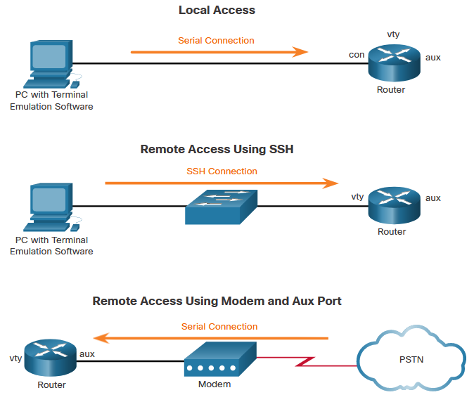
Secure the Edge Router
Secure Local and Remote Access
A router can be accessed for administrative purposes locally or remotely:
Local access - The administrator must have physical access to the router and use a console cable to connect to the console port. Local access is typically used for initial configuration of the device.
Remote access - Although the aux port option is available, the most common remote access method involves allowing Telnet, SSH, HTTP, HTTPS, or SNMP connections to the router from a computer. The computer can be on the local network or a remote network.
Notes:
4: Secure Device Access 4.1: Secure the Edge Router 4.1.5: Secure Local and Remote Access

Slide 9
4.2 Configure Secure Administrative Access
Notes:
4: Secure Device Access 4.2: Configure Secure Administrative Access

Slide 10
Configure Secure Administrative Access
Passwords
The table shows examples of strong and weak passwords.
Weak Password | Why it is Weak
secret | Simple dictionary password
smith | Maiden name of mother
toyota | Make of a car
bob1967 | Name and birthday of the user
Blueleaf23 | Simple words and numbers
Strong Password | Why it is Strong
b67n42d39c | Combines alphanumeric characters
12^h u4@1p7 | Combines alphanumeric characters, symbols, and includes a space
Notes:
4: Secure Device Access 4.2: Configure Secure Administrative Access 4.2.1: Passwords

Slide 11
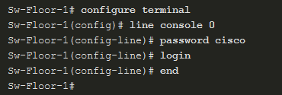

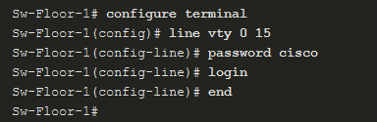
Configure Secure Administrative Access
Configure Passwords
To secure user EXEC mode access, enter line console configuration mode using the line console 0 global configuration command. Specify the user EXEC mode password using the password password command. Enable user EXEC access using the login command.
To have administrator access to all IOS commands including configuring a device, you must gain privileged EXEC mode access. To secure privileged EXEC access, use the enable secret password global config command.
To secure vty lines, enter line vty mode using the line vty 0 15 global config command. Specify the vty password using the password password command. Enable vty access using the login command.
Notes:
4: Secure Device Access 4.2: Configure Secure Administrative Access 4.2.2: Configure Passwords

Slide 12

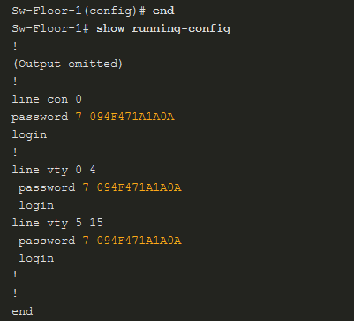
Configure Secure Administrative Access
Encrypt Passwords
Strong passwords are only useful if they are secret. There are several steps that can be taken to help ensure that passwords remain secret on a Cisco router and switch including these:
Encrypting all plaintext passwords
Setting a minimum acceptable password length
Deterring brute-force password guessing attacks
Disabling an inactive privileged EXEC mode access after a specified amount of time.
.
To encrypt all plaintext passwords, use the service password-encryption global config command.
Use the show running-config command to verify that passwords are now encrypted.
Notes:
4: Secure Device Access 4.2: Configure Secure Administrative Access 4.2.3: Encrypt Passwords

Slide 13
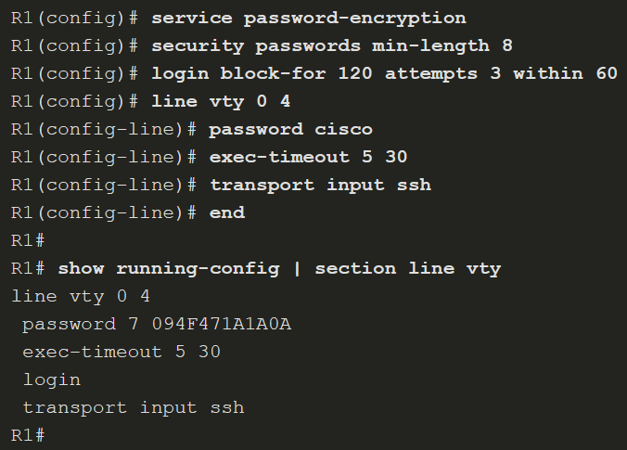
Configure Secure Administrative Access
Additional Password Security
As shown in the sample configuration, the service password-encryption global configuration command prevents unauthorized individuals from viewing plaintext passwords in the configuration file.
To ensure that all configured passwords are a minimum of a specified length, use the security passwords min-length length command in global configuration mode.
Threat actors may use password cracking software to conduct a brute-force attack on a network device. This attack continuously attempts to guess the valid passwords until one works. Use the login block-for seconds attempts number within seconds global configuration command to deter this type of attack.
R1(config)# login quiet-mode access-class myacl
Bude uvedené neskôr ...
show login failures
Notes:
4: Secure Device Access 4.2: Configure Secure Administrative Access 4.2.4: Additional Password Security

Slide 14
Configure Secure Administrative Access
Secret Password Algorithms
MD5 hashes are no longer considered secure because attackers can reconstruct valid certificates. This can allow attackers to spoof any website. The enable secret password uses an MD5 hash by default. It is now recommended that you configure all secret passwords using either type 8 or type 9 passwords. Type 8 and type 9 were introduced in Cisco IOS 15.3(3)M. Type 8 and type 9 use SHA encryption.
To enter an unencrypted password, use the enable algorithm-type command syntax:
Algorithm Keyword | Description
md5 | Type 5; selects the message digest algorithm 5 (MD5) as the hashing algorithm.
scrypt | Type 9; selects scrypt as the hashing algorithm.
sha256 | Type 8: selects Password-Based Key Derivation Function 2 (PBKDF2) with Secure Hash Algorithm, 256-bits (SHA-256) as the hashing algorithm.
R1(config)# enable algorithm-type scrypt secret cisco12345
R1(config)# username Bob algorithm-type scrypt secret cisco54321
Notes:
4: Secure Device Access 4.2: Configure Secure Administrative Access 4.2.5: Secret Password Algorithms
4.2.6: Syntax Checker – Secure Administrative Access on R2

Slide 15
4.3 Configure Enhanced Security for Virtual Logins
Notes:
4: Secure Device Access 4.3: Configure Enhanced Security for Virtual Logins

Slide 16
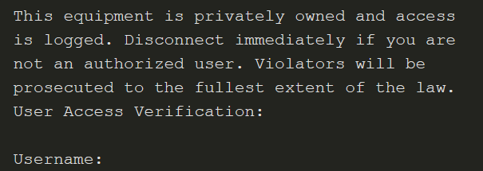
Configure Enhanced Security for Virtual Logins
Enhance the Login Process
Login blocking is enabling a detection profile that lets you configure a network device to react to repeated failed login attempts by refusing further connection requests.
Access control lists (ACLs) can be used to permit legitimate connections from addresses of known system administrators.
Use the banner global configuration mode command to specify appropriate messages. Banners protect the organization from a legal perspective.
Notes:
4: Secure Device Access 4.3: Configure Enhanced Security for Virtual Logins 4.3.1: Enhance the Login Process

Slide 17
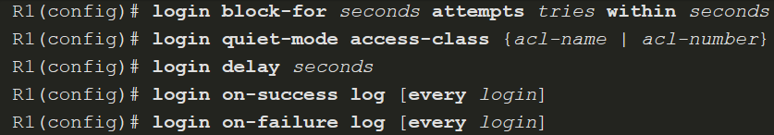
Configure Enhanced Security for Virtual Logins
Configure Login Enhancement Features
The login block-for command can defend against DoS attacks by disabling logins after a specified number of failed login attempts. The login quiet-mode command maps to an ACL that identifies the permitted hosts. The login delay command specifies the number of seconds the user must wait between unsuccessful login attempts. The login on-success and login on-failure commands log successful and unsuccessful login attempts.
Notes:
4: Secure Device Access 4.3: Configure Enhanced Security for Virtual Logins 4.3.2: Configure Login Enhancement Features

Slide 18
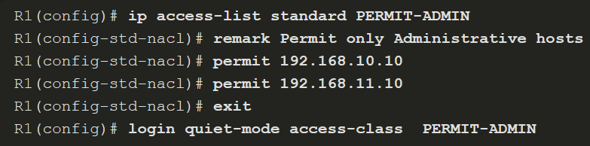
Configure Enhanced Security for Virtual Logins
Enable Login Enhancements
To help a Cisco IOS device provide DoS detection, use the login block-for command, which must be issued before any other login command. The login block-for command monitors login device activity and operates in two modes:
Normal mode - Also called watch mode, the router keeps count of the number of failed login attempts within an identified amount of time.
Quiet mode – Also called the quiet period. If the number of failed logins exceeds the configured threshold, all login attempts using Telnet, SSH, and HTTP are denied for the time specified in the login block-for command.
Notes:
4: Secure Device Access 4.3: Configure Enhanced Security for Virtual Logins 4.3.3: Enable Login Enhancements

Slide 19
Configure Enhanced Security for Virtual Logins
Log Failed Attempts
There are three commands that can be configured to help an administrator detect a password attack. Each lets a device to generate syslog messages for failed or successful login attempts. The first two commands, login on-success log and login on-failure log, generate syslog messages for successful and unsuccessful login attempts. An alternative to the login on-failure log command is the security authentication failure rate command can be configured to generate a log message when the login failure rate is exceeded.
Notes:
4: Secure Device Access 4.3: Configure Enhanced Security for Virtual Logins 4.3.4: Log Failed Attempts 4.3.5: Syntax Checker – Configure Enhanced Login Security on R2

Slide 20
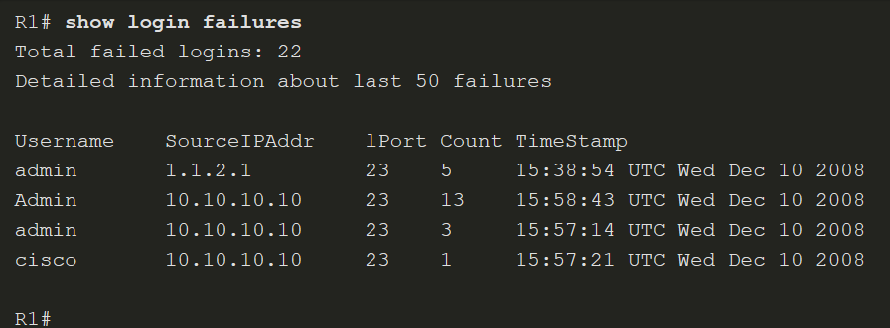
Configure Enhanced Security for Virtual Logins
Log Failed Attempts (Cont.)
Use the show login command to verify the login block-for command settings and current mode.
The show login failures command displays additional information regarding the failed attempts, such as the IP address from which the failed login attempts originated.
Notes:
4: Secure Device Access 4.3: Configure Enhanced Security for Virtual Logins 4.3.4: Log Failed Attempts 4.3.5: Syntax Checker – Configure Enhanced Login Security on R2

Slide 21
4.4 Configure SSH
Notes:
4: Secure Device Access 4.4: Configure SSH

Slide 22
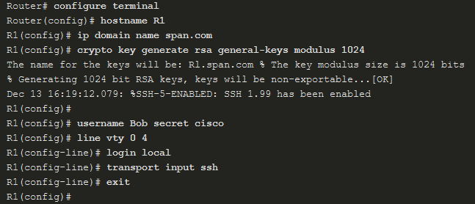
Configure SSH
Enable SSH
Configure a Cisco device to support SSH using the following six steps:
Step 1. Configure a unique device hostname.
Step 2. Configure the IP domain name.
Step 3. Generate a key to encrypt SSH traffic.
Step 4. Verify or create a local database entry.
Step 5. Authenticate against the local database.
Step 6. Enable vty inbound SSH sessions.
Notes:
4: Secure Device Access 4.4: Configure SSH 4.4.2: Enable SSH

Slide 23
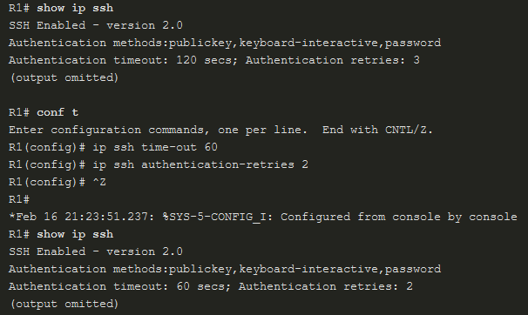
Configure SSH
Enhance SSH Login Security
To verify the optional SSH command settings, use the show ip ssh command. Use the ip ssh time-out seconds global configuration mode command to modify the default 120-second timeout interval. This configures the number of seconds that SSH can use to authenticate a user. By default, a user logging in has three attempts to enter the correct password before being disconnected. To configure a different number of consecutive SSH retries, use the ip ssh authentication-retries integer global configuration mode command.
Notes:
4: Secure Device Access 4.4: Configure SSH 4.4.3: Enhance SSH Login Security
4.4.4: Syntax Checker – Enable SSH on R2

Slide 24

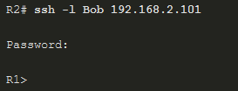
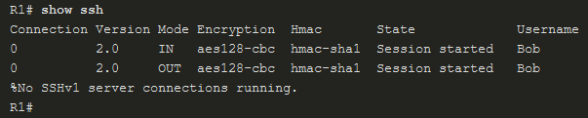
Configure SSH
Connect a Router to an SSH-Enabled Router
To verify the status of the client connections, use the show ssh command. There are two different ways to connect to an SSH-enabled router. By default, when SSH is enabled, a Cisco router can act as an SSH server or SSH client. As a server, a router can accept SSH client connections. As a client, a router can connect via SSH to another SSH-enabled router.
Check SSH Status
Connect from R2
To R1
View SSH Connections
Notes:
4: Secure Device Access 4.4: Configure SSH 4.4.5: Connect a Router to an SSH-Enabled Router

Slide 25
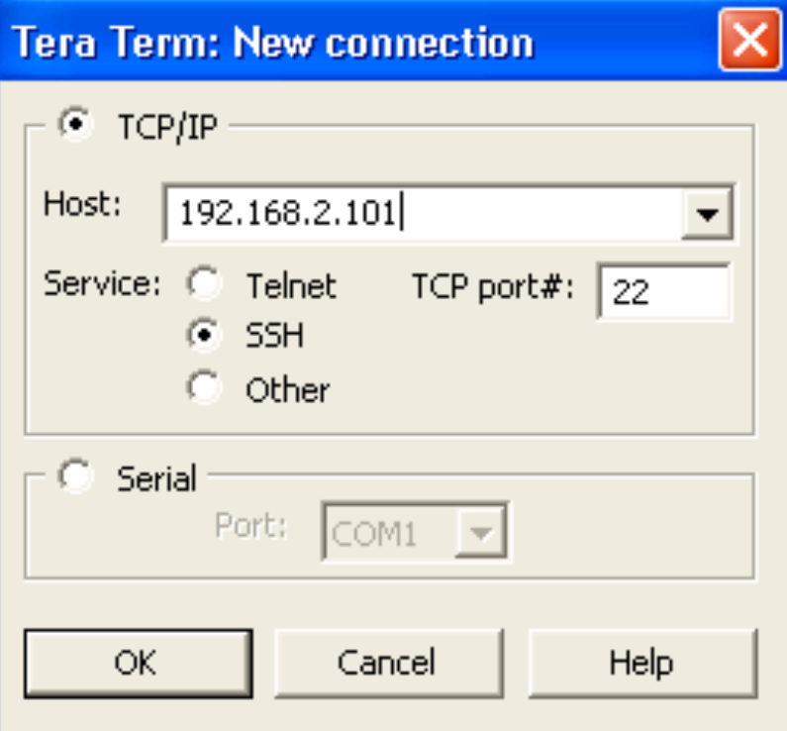
Configure SSH
Connect a Host to an SSH-Enabled Router
Connect using an SSH client (e.g., PuTTY, OpenSSH, TeraTerm) running on a host.
Generally, the SSH client initiates an SSH connection to the router. The router SSH service prompts for the correct username and password combination. After the login is verified, the router can be managed as if the administrator was using a standard Telnet session.
Existuje aj scp …
Notes:
4: Secure Device Access 4.4: Configure SSH 4.4.6: Connect a Host to an SSH-Enabled Router

Slide 26
Module 5: Assigning Administrative Roles
Instructor Materials
Networking Security v1.0
(NETSEC)
Notes:
Networking Security (NETSEC) Module 5: Assigning Administrative Roles

Slide 27
Module Objectives
Module Title: Assigning Administrative Roles
Module Objective: Configure command authorization using privilege levels and role-based CLI.
Topic Title | Topic Objective
Configure Privilege Levels | Use the correct commands to configure administrative privilege levels to control command availability.
Configure Role-Based CLI | Use the correct commands to configure role-based CLI access to control command availability.
Notes:
27
5 – Assigning Administrative Roles
5.0.2 – What will I learn in this module?

Slide 28
5.1 Configure Privilege Levels
Notes:
5: Assigning Administrative Roles 5.1: Configure Privilege Levels

Slide 29
Configure Privilege Levels
Limiting Command Availability
Cisco IOS software can provide infrastructure access using privilege level or role-based CLI.
By default, the Cisco IOS software CLI has two levels of access to commands.
User EXEC mode (privilege level 1), and Privileged EXEC mode (privilege level 15).
There are 16 privilege levels in total.
To assign commands to a custom privilege level, use the privilege mode {level level | reset} command global configuration mode command.
Command | Description
mode | Specifies the configuration mode. Use the privilege ? command to see a complete list of router configuration modes available on your router.
level | (Optional) Enables setting a privilege level with a specified command.
level | (Optional) The privilege level that is associated with a command. You can specify up to 16 privilege levels, using numbers 0 to 15.
reset | (Optional) Resets the privilege level of a command.
command | (Optional) Argument to use when you want to reset the privilege level.
Notes:
5: Assigning Administrative Roles 5.1: Configure Privilege Levels 5.1.1: Limiting Command Availability

Slide 30
Configure Privilege Levels
Configuring and Assigning Privilege Levels
To configure a privilege level with specific commands, use the privilege exec level level [command] global configuration command.
There are two methods for assigning passwords to the different privilege levels:
To assign a privilege level to a specific user, use the username name privilege level secret password global configuration mode command.
To assign a privilege level to a specific EXEC mode, use the enable secret level level password global configuration mode command.
Router(config)# privilege mode {level level | reset} command
Router(config)# username name privilege level secret password
Router(config)# enable secret level level password
Router(config)#license boot module c2900 technology-package securityk9
Notes:
5: Assigning Administrative Roles 5.1: Configure Privilege Levels 5.1.2: Configuring and Assigning Privilege Levels

Slide 31
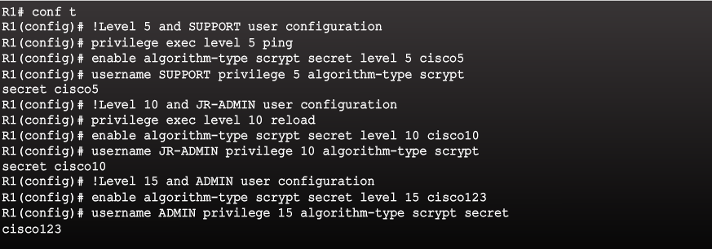
Configuring and Assigning Privilege Levels
Notes:
2.2.1.2 Configuring and Assigning Privilege Levels

Slide 32
Configure Privilege Levels
Limitations of Privilege Levels
The use of privilege levels has its limitations:
There is no access control to specific interfaces, ports, logical interfaces, and slots on a router.
Commands available at lower privilege levels are always executable at higher levels.
Commands specifically set at a higher privilege level are not available for lower privileged users.
Assigning a command with multiple keywords allows access to all commands that use those keywords. For example, allowing access to show ip route allows the user access to all show and show ip commands.
Notes:
5: Assigning Administrative Roles 5.1: Configure Privilege Levels 5.1.3: Limitations of Privilege Levels
5.1.4: Syntax Checker - Configure Privilege Levels on R2

Slide 33
5.2 Configure Role-Based CLI
Notes:
5: Assigning Administrative Roles 5.2: Configure Role-Based CLI

Slide 34
Configure Role-Based CLI
Role-Based CLI Access
The Cisco IOS Release 12.3(11)T feature provides finer, more granular access by controlling which commands are available to specific roles.
Role-based CLI access enables the network administrator to create different views of router configurations for different users.
Role-based CLI access enables the network administrator to create different views of router configurations for different users.
Each view defines the CLI commands that each user can access.
It addresses security, availability, and operational efficiency.
Notes:
5: Assigning Administrative Roles 5.2: Configure Role-Based CLI 5.2.1: Role-Based CLI Access

Slide 35
Configure Role-Based CLI
Role-Based Views
Role-based CLI provides three types of views that dictate which commands are available:
Root View -To configure any view for the system, the administrator must be in root view.
CLI View - A specific set of commands can be bundled into a CLI view.
Superview - A superview consists of one or more CLI views.
Superviews have several specific characteristics:
A single CLI view can be shared within multiple superviews.
Commands cannot be configured for a superview. An administrator must add commands to the CLI view and add that CLI view to the superview.
Users who are logged into a superview can access all the commands that are configured for any of the CLI views that are part of the superview.
Each superview has a password that is used to switch between superviews or from a CLI view to a superview.
Deleting a superview does not delete the associated CLI views. The CLI views remain available to be assigned to another superview.
Notes:
5: Assigning Administrative Roles 5.2: Configure Role-Based CLI 5.2.2: Role-Based Views

Slide 36
Configure Role-Based CLI
Configure Role-Based Views
Musí byť nastavené enable secret heslo ...
There are five steps to create and manage a specific view.
Step 1. Enable AAA with the aaa new-model global configuration mode command. Exit and enter the root view with the enable view command.
Step 2. Create a view using the parser view view-name global configuration mode command. This enables the view configuration mode.
Router(config)# aaa new-model
Router# enable [view [view-name]]
Router(config)# parser view view-name
Notes:
5: Assigning Administrative Roles 5.2: Configure Role-Based CLI 5.2.3: Configure Role-Based Views

Slide 37
Configure Role-Based CLI
Configure Role-Based Views (Cont.)
Step 3. Assign a secret password to the view using the secret password view configuration mode command.
Step 4. Assign commands to the selected view using the commands parser-mode command in view configuration mode.
Router(config-view)# secret password
Router(config-view)# commands parser-mode {include | include-exclusive | exclude} [all] [interface interface-name | command]
Step 5. Exit view configuration mode by typing the exit command.
Notes:
5: Assigning Administrative Roles 5.2: Configure Role-Based CLI 5.2.3: Configure Role-Based Views

Slide 38
Configure Role-Based CLI
Configure Role-Based Views (Cont.)
Below is a list of commands and the description.
Commands | Description
commands | Adds commands or interfaces to a view.
parser-mode | The mode in which the specified command exists; for example, EXEC mode.
include | Adds a command or an interface to the view and allows the same command or interface to be added to other views.
include-exclusive | Adds a command or an interface to the view and excludes the same command or interface from being added to all other views.
exclude | Excludes a command or an interface from the view.
All | A "wildcard" that allows every command in a specified configuration mode that begins with the same keyword or every subinterface for a specified interface to be part of the view.
interface interface-name | Interface that is added to the view.
command | Command that is added to the view.
Notes:
5: Assigning Administrative Roles 5.2: Configure Role-Based CLI 5.2.3: Configure Role-Based Views 5.2.4: Syntax Checker - Configure Views on R2

Slide 39
Configure Role-Based CLI
Configure Role-Based CLI Superviews
The steps to configure a superview are essentially the same as configuring a CLI view, except that the view view-name command is used to assign commands to the superview.
Step 1. Create a view using the parser view view-name superview command and enter superview configuration mode.
Step 2. Assign a secret password to the view using the secret password command. This sets a password to protect access to the superview.
Router(config)# parser view view-name superview
Router(config-view)# secret password
Notes:
5: Assigning Administrative Roles 5.2: Configure Role-Based CLI 5.2.6: Configure Role-Based CLI Superviews

Slide 40
Configure Role-Based CLI
Configure Role-Based CLI Superviews (Cont.)
Step 3. Assign an existing view using the view view-name command in view configuration mode. This adds a CLI view to superview.
Step 4. Exit superview configuration mode by typing the exit command.
Router(config-view)# view view-name
Notes:
5: Assigning Administrative Roles 5.2: Configure Role-Based CLI 5.2.6: Configure Role-Based CLI Superviews
5.2.7: Syntax Checker - Configure Superviews on R2

Slide 41
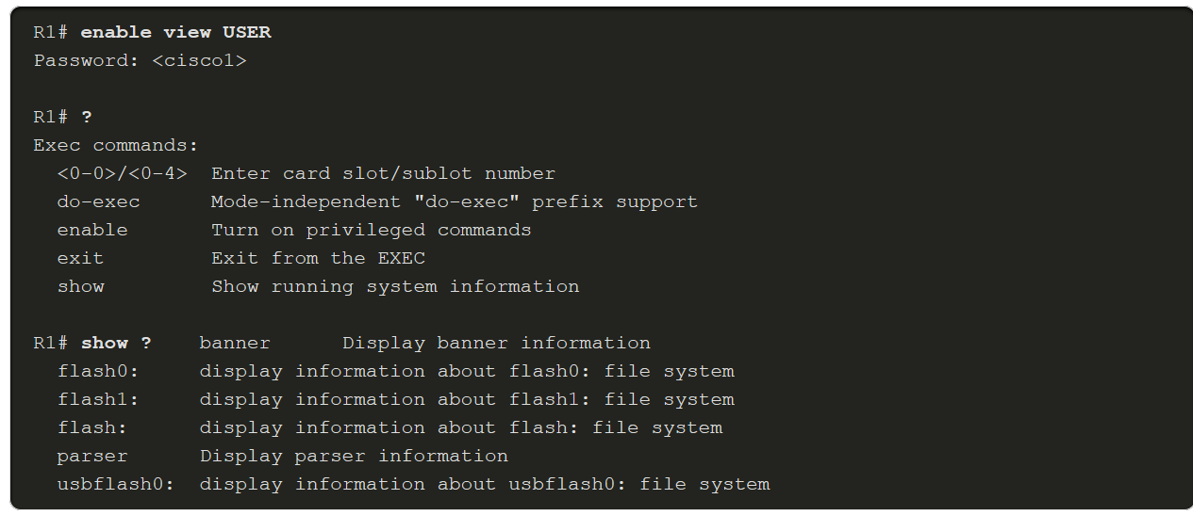
Configure Role-Based CLI
Verify Role-Based CLI Views
To verify a view, use the enable view view-name command. Enter the name of the view to verify and provide the password to log into the view. Use the question mark (?) command to verify that the commands available in the view are correct. The example enables the USER superview and lists the commands available in the view.
Notes:
5: Assigning Administrative Roles 5.2: Configure Role-Based CLI 5.2.8: Verify Role-Based CLI Views

Slide 42
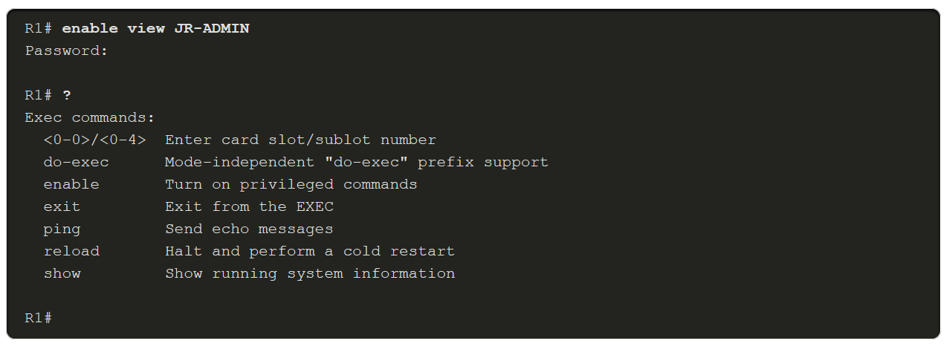
Configure Role-Based CLI
Verify Role-Based CLI Views (Cont.)
This example enables the JR-ADMIN view and lists the commands available in the view.
By not specifying a view for the enable view command, you can log in as root. From the root view, use the show parser view all command to see a summary of all views.
Notes:
5: Assigning Administrative Roles 5.2: Configure Role-Based CLI 5.2.8: Verify Role-Based CLI Views

Slide 43
Role-Based CLI Views
R2(config)#enable secret cisco
R2(config)#aaa new-model
! For automatic user login with view ....
R2(config)# aaa authentication login default local
R2(config)# aaa authorization console
R2(config)# aaa authorization exec default local
!
R2(config)# username XXX view vw01 secret cisco
R2(config)#end
R2#enable view
R2(config)#parser view vw01
R2(config-view)#secret cisco
R2(config-view)#commands exec include ping
R2(config-view)#commands exec include all show
Note:
Router# enable view vw01
Router# Show parser view
Router# disable
-nefunguje v PT
R2(config)# parser view support superview
R2(config-view)# secret SUPPORT-HESLO
R2(config-view)# view monitor
R2(config-view)# view diagnostics

Slide 44
Module 6: Device Monitoring and Management
Instructor Materials
Networking Security v1.0
(NETSEC)
Notes:
Networking Security (NETSEC) Module 6: Monitoring and Managing Devices

Slide 45
Module Objectives
Module Title: Device Monitoring and Management
Module Objective: Implement the secure management and monitoring of network devices.
Topic Title | Topic Objective
Secure Cisco IOS Image and Configuration Files | Explain how the Cisco IOS resilient configuration feature and Secure Copy are used to secure the Cisco IOS image and configuration files.
Lock Down a Router Using AutoSecure | Use the correct commands for AutoSecure to enable security on IOS-based routers.
Routing Protocol Authentication | Use the correct command to configure routing protocol authentication.
Secure Management and Reporting | Compare in-band and out-of-band management access.
Network Security Using Syslog | Explain how to configure syslog to log system events.
NTP Configuration | Configure NTP to enable accurate timestamping between all devices.
SNMP Configuration | Configure SNMP to monitor system status.
Notes:
45

Slide 46
6.1 Secure Cisco IOS Image and Configuration Files
Notes:
6: Device Monitoring and Management 6.1: Secure Cisco IOS Image and Configuration Files

Slide 47
Secure Cisco IOS Image and Configuration Files
Cisco IOS Resilient Configuration Feature
The Cisco IOS resilient configuration feature allows for faster recovery if someone maliciously or unintentionally reformats flash memory or erases the startup configuration file in nonvolatile random-access memory (NVRAM).
The configuration file in the primary bootset is a copy of the running configuration that was in the router when the feature was first enabled.
The feature secures the smallest working set of files to preserve persistent storage space.
No extra space is required to secure the primary Cisco IOS image file. The feature automatically detects image or configuration version mismatch.
Only local storage is used for securing files.
The feature can be disabled only through a console session.
Notes:
6: Device Monitoring and Management 6.1: Secure Cisco IOS Image and Configuration Files 6.1.1: Cisco IOS Resilient Configuration Feature

Slide 48
Secure Cisco IOS Image and Configuration Files
Enabling the IOS Image Resilience Feature
To secure the IOS image and enable Cisco IOS image resilience, use the secure boot-image global configuration mode command. When enabled for the first time, the running Cisco IOS image is secured, and a log entry is generated.
The Cisco IOS image resilience feature can only be disabled through a console session using the no form of the command. Use the show secure bootset command to verify the existence of the archive.
Notes:
6: Device Monitoring and Management 6.1: Secure Cisco IOS Image and Configuration Files 6.1.2: Enabling the IOS Image Resilience Feature

Slide 49
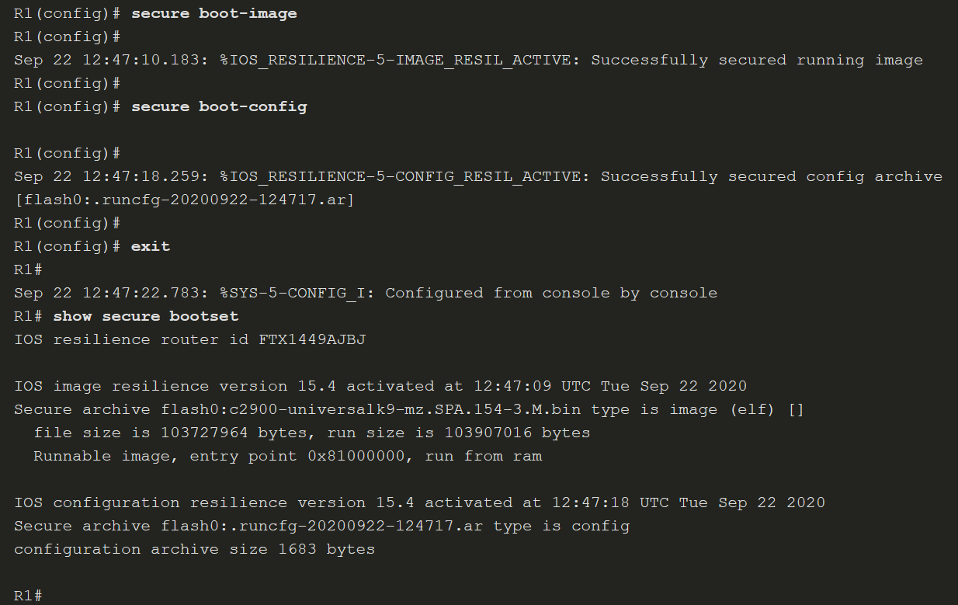
Secure Cisco IOS Image and Configuration Files
Enabling the IOS Image Resilience Feature (Cont.)
Notes:
6: Device Monitoring and Management 6.1: Secure Cisco IOS Image and Configuration Files 6.1.2: Enabling the IOS Image Resilience Feature

Slide 50
Secure Cisco IOS Image and Configuration Files
The Primary Bootset Image
Restore a primary bootset from a secure archive after the router has been tampered with, as follows:
Step 1. Reload the router using the reload command. If necessary, issue the break sequence to enter ROM monitor (ROMmon) mode.
Step 2. From ROMmon mode, enter the dir command to list the contents of the device that contains the secure bootset file.
Step 3. Boot the router with the secure bootset image using the boot command followed by the flash memory location (e.g. flash0), a colon, and the filename found in Step 2.
Step 4. Enter global configuration mode and restore the secure configuration to a filename of your choice using the secure boot-config restore command followed by the flash memory location (e.g. flash0), a colon, and a filename of your choice. In the figure, the filename rescue-cfg is used.
Step 5. Exit global configuration mode and issue the copy command to copy the rescued configuration file to the running configuration.
Notes:
6: Device Monitoring and Management 6.1: Secure Cisco IOS Image and Configuration Files 6.1.3: The Primary Bootset Image

Slide 51
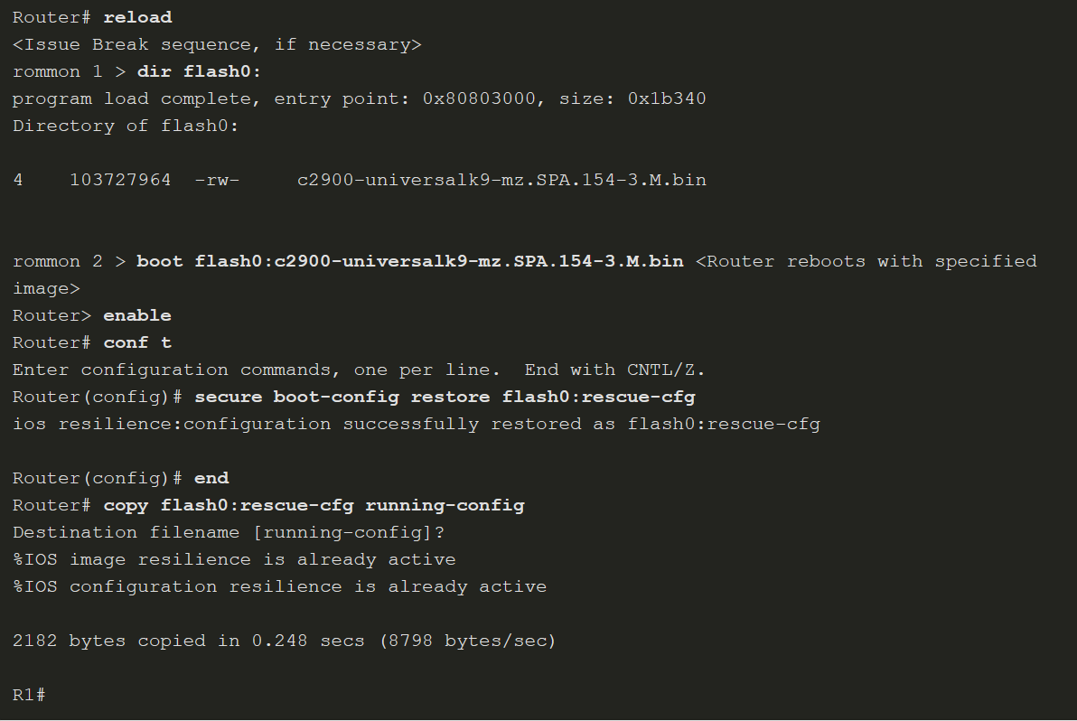
Secure Cisco IOS Image and Configuration Files
The Primary Bootset Image (Cont.)
Notes:
6: Device Monitoring and Management 6.1: Secure Cisco IOS Image and Configuration Files 6.1.3: The Primary Bootset Image

Slide 52
Secure Cisco IOS Image and Configuration Files
Configuring Secure Copy
The Secure Copy Protocol (SCP) feature is used to remotely copy IOS and configuration files. SCP provides a secure and authenticated method for copying router configuration or router image files to a remote location. SRC relies on SCP relies on SSH to secure communication and AAA to provide authentication and authorization.
Configure the router for server-side SCP with local AAA:
Step 1. Configure SSH, if not already configured.
Step 2. For local authentication, configure at least one local database user with privilege level 15.
Step 3. Enable AAA with the aaa new-model global configuration mode command.
Step 4. Use the aaa authentication login default local command to specify that the local database be used for authentication.
Step 5. Use the aaa authorization exec default local command to configure command authorization. In this example, all local users will have access to EXEC commands.
Step 6. Enable SCP server-side functionality with the ip scp server enable command.
Notes:
6: Device Monitoring and Management 6.1: Secure Cisco IOS Image and Configuration Files 6.1.4: Configuring Secure Copy

Slide 53
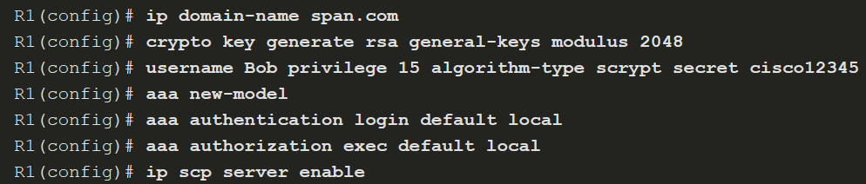
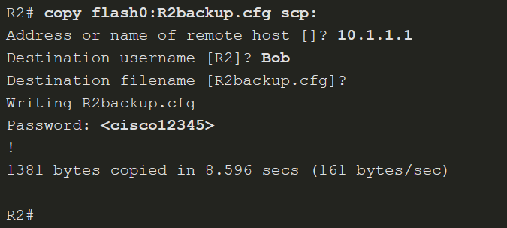
Secure Cisco IOS Image and Configuration Files
Configuring Secure Copy (Cont.)
Notes:
6: Device Monitoring and Management 6.1: Secure Cisco IOS Image and Configuration Files 6.1.4: Configuring Secure Copy

Slide 54
Secure Cisco IOS Image and Configuration Files
Recover a Router Password
Recover Router Passwords Steps
Step 1. | Connect to the console port.
Step 2. | Record the configuration register setting.
Step 3. | Power cycle the router.
Step 4. | Issue the break sequence.
Step 5. | Change the default configuration register with the confreg 0x2142 command.
Step 6. | Reboot the router.
Step 7. | Press Ctrl-C to skip the initial setup procedure.
Step 8. | Put the router into privileged EXEC mode.
Step 9. | Copy the startup configuration to the running configuration.
Step 10. | Verify the configuration.
Step 11. | Change the enable secret password.
Step 12. | Enable all interfaces.
Step 13. | Return the configuration-register to the original setting recorded from Step 2. Use the config-register global config command.
Step 14. | Save the configuration changes.
If a router is compromised or needs to be recovered from a misconfigured password, an administrator must use password recovery procedures, such as those shown in the table.
Notes:
6: Device Monitoring and Management 6.1: Secure Cisco IOS Image and Configuration Files 6.1.5: Recovering a Router Password

Slide 55
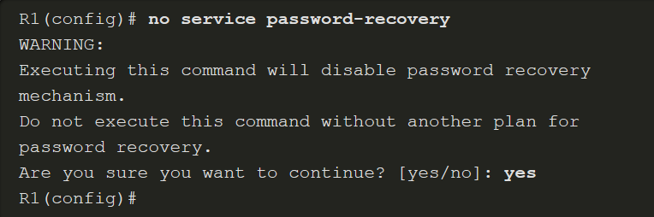
Secure Cisco IOS Image and Configuration Files
Password Recovery
If someone gained physical access to a router, they could potentially gain control of that device through the password recovery procedure.
An administrator can mitigate this potential security breach by using the no service password-recovery global configuration mode command. This command is a hidden Cisco IOS command and has no arguments or keywords. When the no service password-recovery command is entered, a warning message displays and must be acknowledged before the feature is enabled, as shown in the figure.
Notes:
6: Device Monitoring and Management 6.1: Secure Cisco IOS Image and Configuration Files 6.1.6: Password Recovery

Slide 56
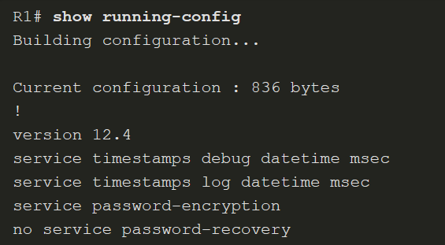
Secure Cisco IOS Image and Configuration Files
Password Recovery (Cont.)
When it is configured, the show running-config command displays a no service password-recovery statement, as shown here.
Notes:
6: Device Monitoring and Management 6.1: Secure Cisco IOS Image and Configuration Files 6.1.6: Password Recovery

Slide 57
Secure Cisco IOS Image and Configuration Files
Password Recovery (Cont.)
To recover a device after the no service password-recovery command is entered, initiate the break sequence within five seconds after the image decompresses during the boot.
You are prompted to confirm the break key action. After the action is confirmed, the startup configuration is completely erased, the password recovery procedure is enabled, and the router boots with the factory default configuration.
If you do not confirm the break action, the router boots normally with the no service password-recovery command enabled.

Slide 58
6.2 Lock Down a Router Using AutoSecure
Notes:
6: Device Monitoring and Management 6.2: Lock Down a Router Using AutoSecure

Slide 59
Lock Down a Router Using AutoSecure
Discovery Protocols CDP and LLDP
Some of the default services can make the device vulnerable to attack if security is not enabled.
The Cisco Discovery Protocol (CDP) is an example of a service that is enabled by default on Cisco routers.
The Link Layer Discovery Protocol (LLDP) is an open standard that can be enabled on Cisco devices, as well as other vendor devices that support LLDP.
The intent of CDP and LLDP is to make it easier for administrators to discover and troubleshoot other devices on the network. However, because of the security implications, these discovery protocols should be used with caution.
Edge devices are an example of a device that should have this feature disabled.
Notes:
6: Device Monitoring and Management 6.2: Lock Down a Router Using AutoSecure 6.2.1: Discovery Protocols CDP and LLDP

Slide 60
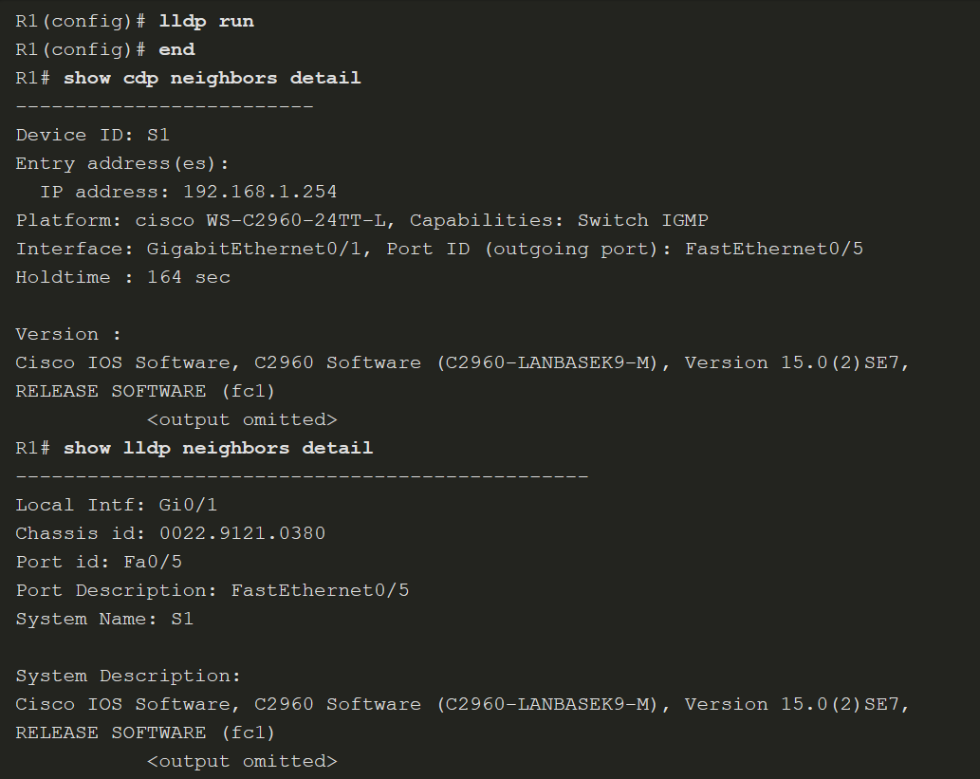
Lock Down a Router Using AutoSecure
Discovery Protocols CDP and LLDP (Cont.)
LLDP configuration and verification is similar to CDP.
Notes:
6: Device Monitoring and Management 6.2: Lock Down a Router Using AutoSecure 6.2.1: Discovery Protocols CDP and LLDP

Slide 61
Lock Down a Router Using AutoSecure
Settings for Protocols and Services
Attackers choose services and protocols that make the network more vulnerable to malicious exploitation. Many of these features should be disabled or restricted in their capabilities based on the security needs of an organization. These features range from network discovery protocols, such as CDP and LLDP, to globally available protocols such as ICMP and other scanning tools.
The table summarizes the feature and default settings for protocols and services.
Feature | Default
Cisco Discovery Protocol (CDP) | Enabled
Link Layer Discovery Protocol (LLDP) | Disabled
Configuration autoloading | Disabled
FTP server | Disabled
TFTP server | Disabled
Network Time Protocol (NTP) service | Disabled
Packet assembler/disassembler (PAD) service | Enabled
TCP and User Datagram Protocol (UDP) minor services | Enabled in versions 11.3 and later
Maintenance Operation Protocol (MOP) service | Enabled on most Ethernet interfaces
Notes:
6: Device Monitoring and Management 6.2: Lock Down a Router Using AutoSecure 6.2.2: Settings for Protocols and Services

Slide 62
Lock Down a Router Using AutoSecure
Cisco AutoSecure
AutoSecure can lock down the management plane functions and the forwarding plane services and functions of a router. There are several management plane services and functions:
Secure BOOTP, CDP, FTP, TFTP, PAD, UDP, and TCP small servers, MOP, ICMP (redirects, mask-replies), IP source routing, Finger, password encryption, TCP keepalives, gratuitous ARP, proxy ARP, and directed broadcast
Legal notification using a banner
Secure password and login functions
Secure NTP
Secure SSH access
TCP intercept services
There are three forwarding plane services and functions that AutoSecure enables:
Cisco Express Forwarding (CEF)
Traffic filtering with ACLs
Cisco IOS firewall inspection for common protocols
Notes:
6: Device Monitoring and Management 6.2: Lock Down a Router Using AutoSecure 6.2.3: Cisco AutoSecure

Slide 63
Lock Down a Router Using AutoSecure
Cisco AutoSecure Command Syntax
Use the auto secure command to enable the Cisco AutoSecure feature setup. This setup can be interactive or non-interactive. The figure shows the command syntax for the auto secure command.
Parameter | Description
no-interact | (Optional) The user will not be prompted for any interactive configurations. No interactive dialogue parameters will be configured, including usernames or passwords.
forwarding | (Optional) Only the forwarding plane will be secured.
management | (Optional) Only the management plane will be secured.
Notes:
6: Device Monitoring and Management 6.2: Lock Down a Router Using AutoSecure 6.2.4: Using the Cisco AutoSecure Feature

Slide 64
Lock Down a Router Using AutoSecure
Using the auto secure Command
When the auto secure command is initiated, a CLI wizard steps the administrator through the configuration of the device. User input is required.
Step 1. The auto secure command is entered. The router displays the AutoSecure configuration wizard welcome message.
Step 2. The wizard gathers information about the outside interfaces.
Step 3. AutoSecure secures the management plane by disabling unnecessary services.
Step 4. AutoSecure prompts for a banner.
Step 5. AutoSecure prompts for passwords and enables password and login features.
Step 6. Interfaces are secured.
Step 7. The forwarding plane is secured.
AutoSecure should be used when a router is initially being configured. It is not recommended on production routers.
Notes:
6: Device Monitoring and Management 6.2: Lock Down a Router Using AutoSecure 6.2.5: Using the auto secure Command
6.2.6: Syntax Checker - Using the auto secure Command

Slide 65
6.3 Routing Protocol Authentication
Notes:
6: Device Monitoring and Management 6.3: Routing Protocol Authentication

Slide 66
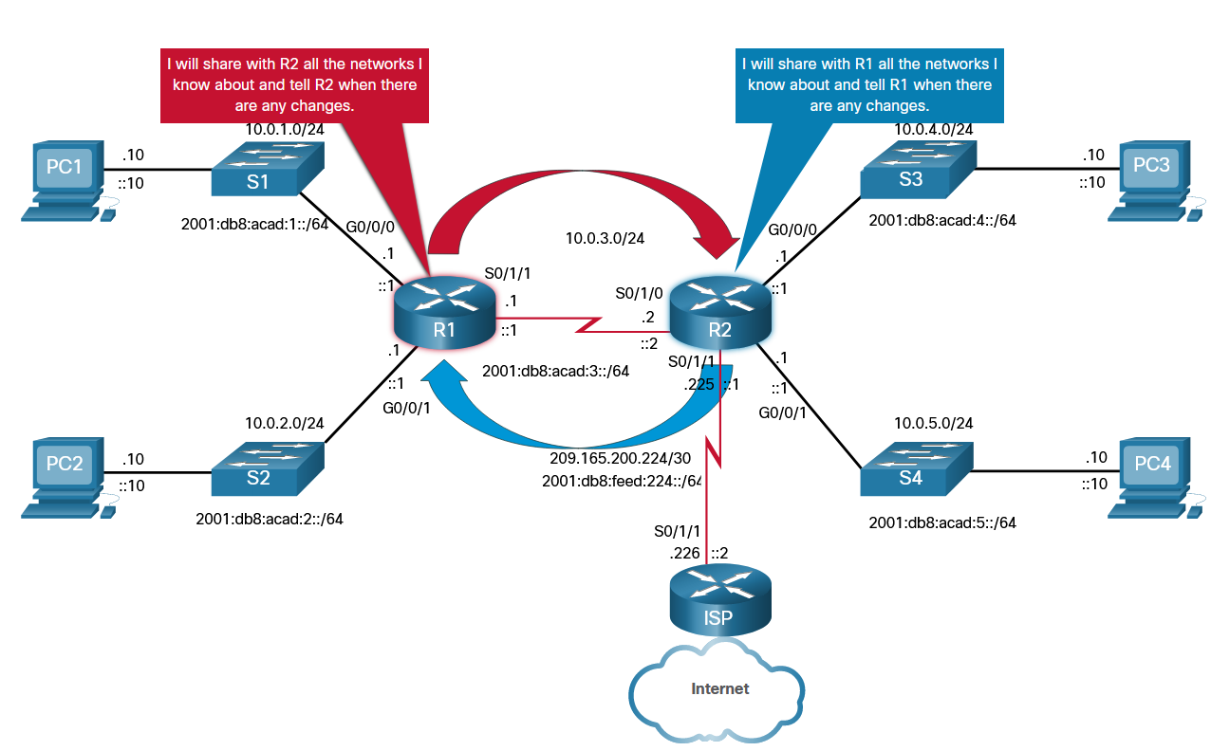
Routing Protocol Authentication
Dynamic Routing Protocols
Dynamic routing protocols perform several activities: including network discovery and maintaining routing tables.
Important advantages of dynamic routing protocols are the ability to select a best path, and the ability to automatically discover a new best path when there is a change in the topology.
A dynamic routing protocol allows the routers to automatically learn about these networks from other routers.
The figure shows routers R1 and R2 using a common routing protocol to share network information.
Notes:
6: Device Monitoring and Management 6.3: Routing Protocol Authentication 6.3.1: Dynamic Routing Protocols

Slide 67
Routing Protocol Authentication
Routing Protocol Spoofing
Routing systems can be attacked by disrupting peer network routers, or by falsifying or spoofing the information carried within the routing protocols. Spoofing routing information may generally be used to cause systems to misinform (lie to) each other, cause a DoS attack, or cause traffic to follow a path it would not normally follow.
There are several consequences of routing information being spoofed:
Redirecting traffic to create routing loops
Redirecting traffic so it can be monitored on an insecure link
Redirecting traffic to discard it
Notes:
6: Device Monitoring and Management 6.3: Routing Protocol Authentication 6.3.2: Routing Protocol Spoofing

Slide 68
Routing Protocol Authentication
OSPF MD5 Routing Protocol Authentication
Enable OSPF MD5 authentication globally:
ip ospf message-digest-key key md5 password interface configuration command.
area area-id authentication message-digest router configuration command.
This method forces authentication on all OSPF enabled interfaces. If an interface is not configured with the ip ospf message-digest-key command, it will not be able to form adjacencies with other OSPF neighbors.
Enable MD5 authentication on a per interface basis:
ip ospf message-digest-key key md5 password interface configuration command.
ip ospf authentication message-digest interface configuration command.
Notes:
6: Device Monitoring and Management 6.3: Routing Protocol Authentication 6.3.3: OSPF MD5 Routing Protocol Authentication

Slide 69
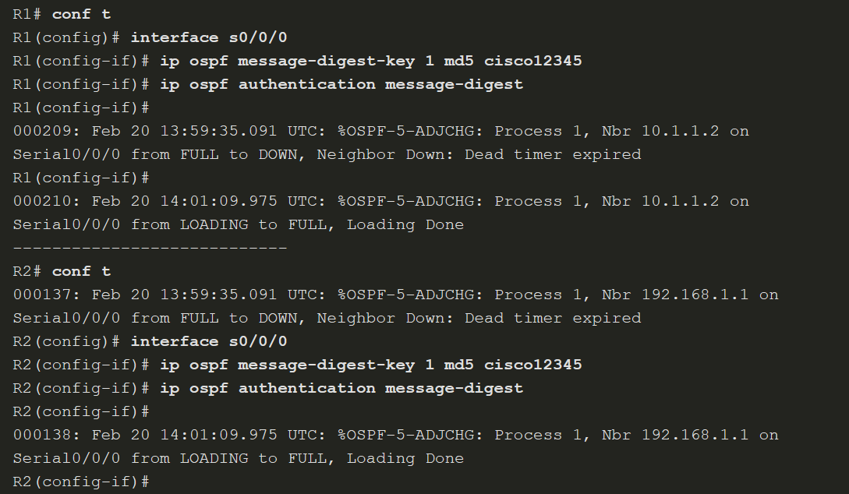
Routing Protocol Authentication
OSPF MD5 Routing Protocol Authentication (Cont.)
Notes:
6: Device Monitoring and Management 6.3: Routing Protocol Authentication 6.3.3: OSPF MD5 Routing Protocol Authentication

Slide 70
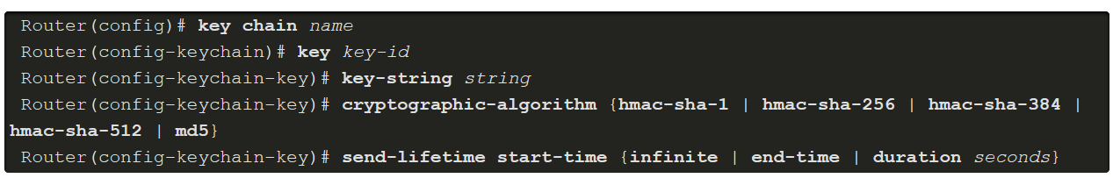
Routing Protocol Authentication
OSPF SHA Routing Protocol Authentication
MD5 is now considered vulnerable to attacks and should only be used when stronger authentication is not available. Administrators should use SHA authentication as long as all of the router operating systems support OSPF SHA authentication.
Step 1. Specify an authentication key chain in global configuration mode:
Configure a key chain name with the key chain command.
Assign the key chain a number and a password with the key and key-string commands.
Specify SHA authentication with the cryptographic-algorithm command.
(Optional) Specify when this key will expire with the send-lifetime command.
Notes:
6: Device Monitoring and Management 6.3: Routing Protocol Authentication 6.3.4: OSPF SHA Routing Protocol Authentication

Slide 71

Routing Protocol Authentication
OSPF SHA Routing Protocol Authentication (Cont.)
Step 2. Assign the authentication key to the desired interfaces with the ip ospf authentication key-chain command.
The next slide shows an SHA authentication example for R1 and R2.
Notes:
6: Device Monitoring and Management 6.3: Routing Protocol Authentication 6.3.4: OSPF SHA Routing Protocol Authentication 6.3.5: Syntax Checker- OSPF SHA Routing Protocol Authentication

Slide 72
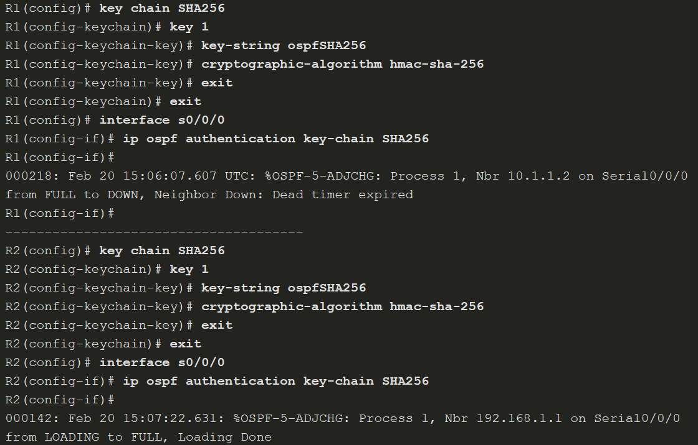
Routing Protocol Authentication
OSPF SHA Routing Protocol Authentication (Cont.)
Notes:
6: Device Monitoring and Management 6.3: Routing Protocol Authentication 6.3.4: OSPF SHA Routing Protocol Authentication 6.3.5: Syntax Checker- OSPF SHA Routing Protocol Authentication

Slide 73
6.4 Secure Management and Reporting
Notes:
6: Device Monitoring and Management 6.4: Secure Management and Reporting

Slide 74
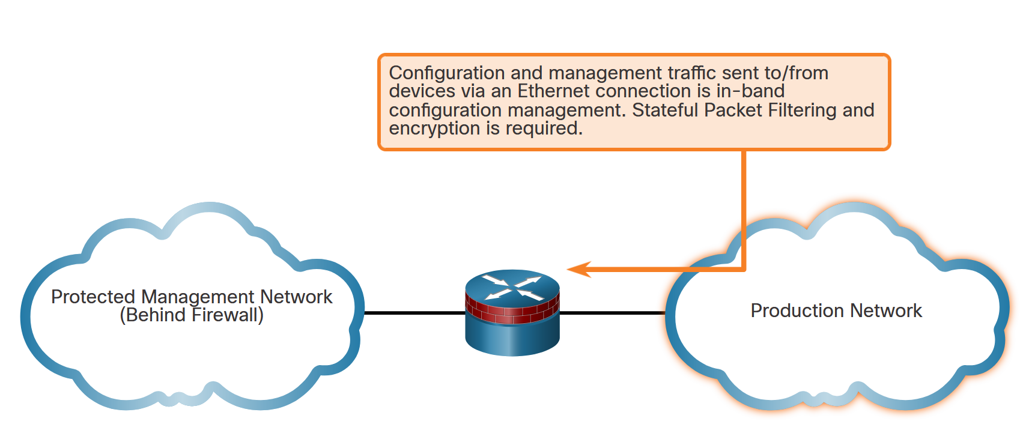
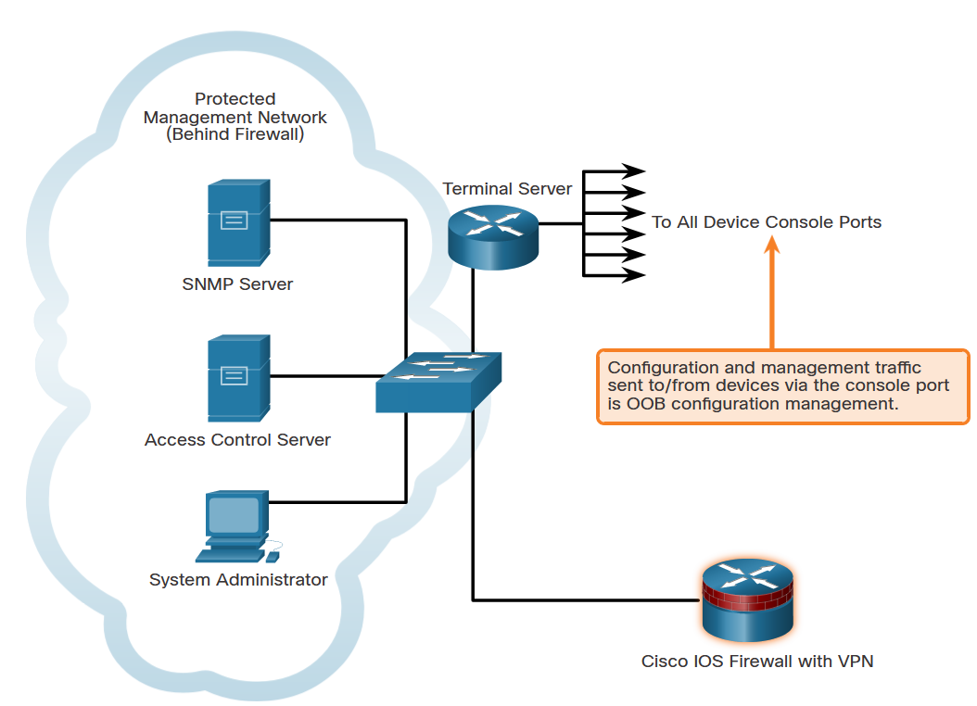
Secure Management and Reporting
Types of Management Access
(From a reporting standpoint, most networking devices can send log data that can be invaluable when troubleshooting network problems or security threats. This data can be viewed in real time, on demand, and in scheduled reports.
When logging and managing information, the information flow between management hosts and the managed devices can take two paths:
In-band - Information flows across an enterprise production network, the Internet, or both, using regular data channels.
Out-of-band (OOB) - Information flows on a dedicated management network on which no production traffic resides.
Notes:
6: Device Monitoring and Management 6.4: Secure Management and Reporting 6.4.1: Determining the Type of Management Access

Slide 75
Secure Management and Reporting
Out-of-Band and In-Band Access
As a general rule, for security purposes, OOB management is appropriate for large enterprise networks. However, it is not always desirable. The decision to use OOB management depends on the type of management applications running and the protocols being monitored.
OOB management guidelines are:
Provide the highest level of security.
Mitigate the risk of passing insecure management protocols over the production network.
In-band management is recommended in smaller networks as a means of achieving a more cost-effective security deployment. In such architectures, management traffic flows in-band in all cases. It is made as secure as possible using secure management protocols, for example using SSH instead of Telnet.
In-band management guidelines are:
Apply only to devices that need to be managed or monitored.
Use IPsec, SSH, or SSL when possible.
Decide whether the management channel needs to be open at all times.
Notes:
6: Device Monitoring and Management 6.4: Secure Management and Reporting 6.4.2: Out-of-Band and In-Band Access

Slide 76
6.5 Network Security Using Syslog
Notes:
6: Device Monitoring and Management 6.5: Network Security Using Syslog

Slide 77
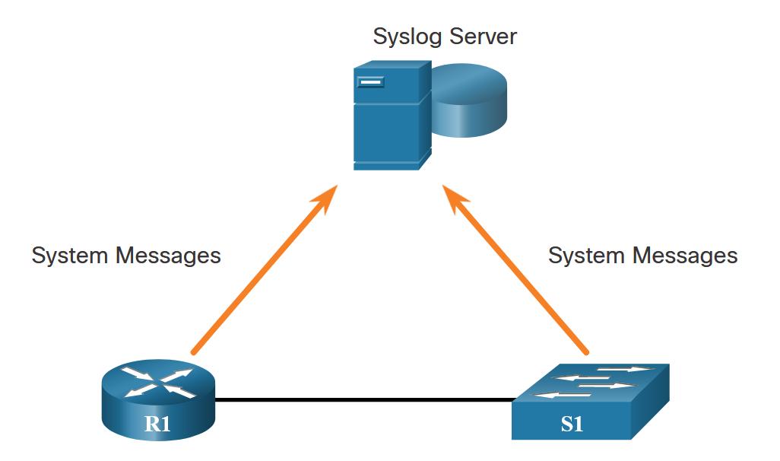
Network Security Using Syslog
Introduction to Syslog
The most common method of accessing system messages is to use a protocol called syslog.
Syslog is a term used to describe a standard. It is also used to describe the protocol developed for that standard. Many networking devices support syslog, including routers, switches, application servers, firewalls, and other network appliances. The syslog protocol allows networking devices to send their system messages across the network to syslog servers.
The syslog logging service provides three primary functions, as follows:
The ability to gather logging information for monitoring and troubleshooting
The ability to select the type of logging information that is captured
The ability to specify the destinations of captured syslog messages
Notes:
6: Device Monitoring and Management 6.5: Network Security Using Syslog 6.5.1: Introduction to Syslog

Slide 78
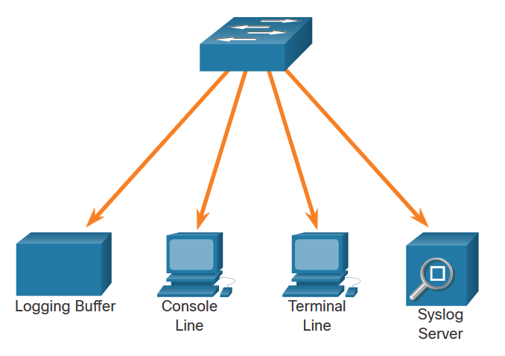
Network Security Using Syslog
Syslog Operation
On Cisco network devices, the syslog protocol starts by sending system messages and debug output to a local logging process that is internal to the device. How the logging process manages these messages and outputs is based on device configurations.
As shown in the figure, popular destinations for syslog messages include the:
Logging buffer (RAM inside a router or switch)
Console line
Terminal line
Syslog server
It is possible to remotely monitor system messages by viewing the logs on a syslog server, or by accessing the device through Telnet, SSH, or through the console port.
Notes:
6: Device Monitoring and Management 6.5: Network Security Using Syslog 6.5.2: Syslog Operation

Slide 79
Network Security Using Syslog
Syslog Message Format
Cisco devices produce syslog messages as a result of network events. Every syslog message contains a severity level and a facility.
The smaller numerical levels are the more critical syslog alarms.
Severity Name | Severity Level | Description
Emergency | Level 0 | System Unusable
Alert | Level 1 | Immediate Action Needed
Critical | Level 2 | Critical Condition
Error | Level 3 | Error Condition
Warning | Level 4 | Warning Condition
Notification | Level 5 | Normal, but Significant Condition
Informational | Level 6 | Informational Message
Debugging | Level 7 | Debugging Message
Notes:
6: Device Monitoring and Management 6.5: Network Security Using Syslog 6.5.3: Syslog Message Format

Slide 80
Network Security Using Syslog
Syslog Facilities
Syslog facilities are service identifiers that identify and categorize system state data for error and event message reporting. The logging facility options that are available are specific to the networking device.
By default, the format of syslog messages on the Cisco IOS Software is as follows:
For example, sample output on a Cisco switch for an EtherChannel link changing state to up is:
Here the facility is LINK and the severity level is 3, with a MNEMONIC of UPDOWN
Notes:
6: Device Monitoring and Management 6.5: Network Security Using Syslog 6.5.4: Syslog Facilities

Slide 81
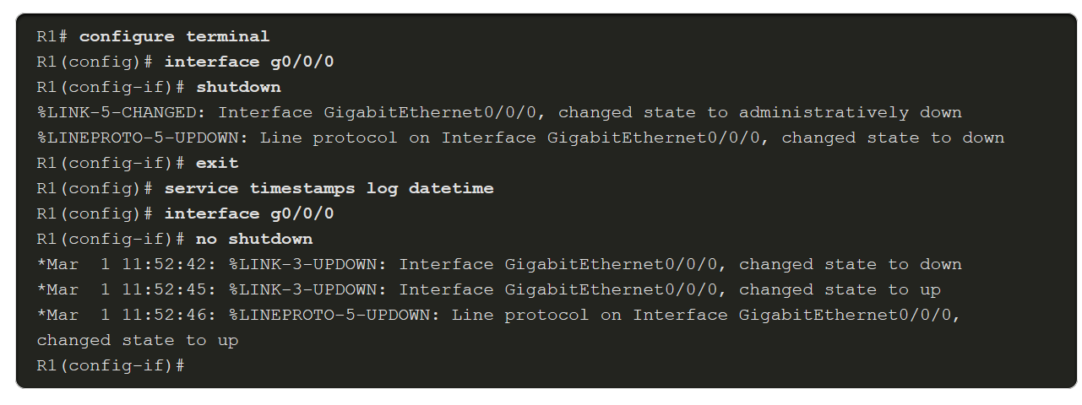
Network Security Using Syslog
Configure Syslog Timestamps
By default, log messages are not timestamped. Log messages should be timestamped so that when they are sent to another destination, such as a Syslog server, there is record of when the message was generated.
Use the command service timestamps log datetime to force logged events to display the date and time. As shown in the command output, when the R1 GigabitEthernet 0/0/0 interface is reactivated, the log messages now contain the date and time.
Notes:
6: Device Monitoring and Management 6.5: Network Security Using Syslog 6.5.5: Configure Syslog Timestamps
6.5.6: Check Your Understanding - Syslog Operation

Slide 82
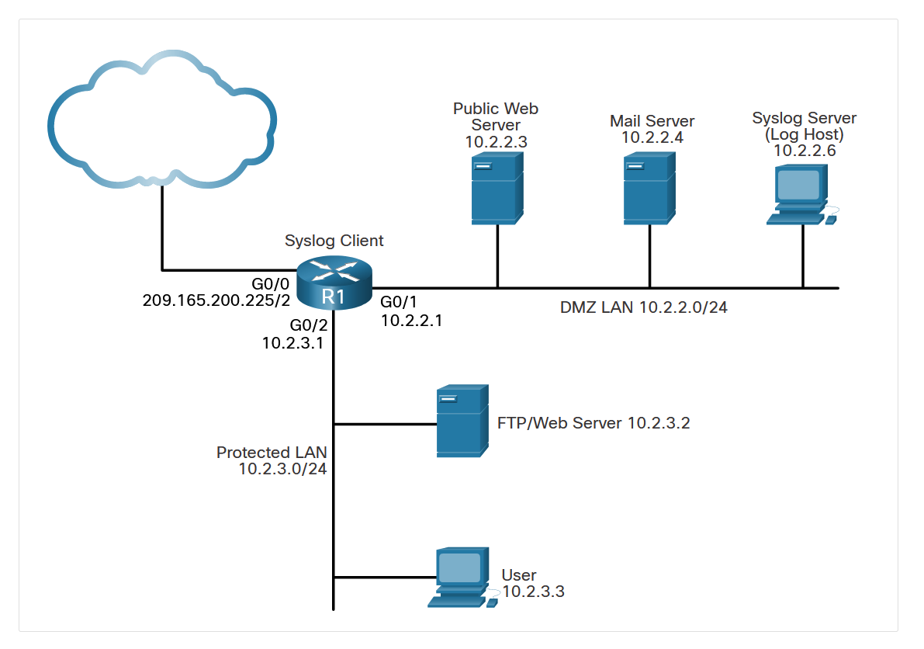
Network Security Using Syslog
Syslog Systems
Cisco smerovače umožňujú konfiguráciu až osem syslog serverov.
Syslog implementations always contain two types of systems:
Syslog servers - Also known as log hosts, these systems accept and process log messages from syslog clients.
Syslog clients - Routers or other types of equipment that generate and forward log messages to syslog servers.
The topology in the figure identifies the syslog server at IP address 10.2.2.6. The rest of the servers and devices in the topology can be configured as syslog clients, which send syslog messages to the syslog server.
Notes:
6: Device Monitoring and Management 6.5: Network Security Using Syslog 6.5.7: Syslog Systems

Slide 83
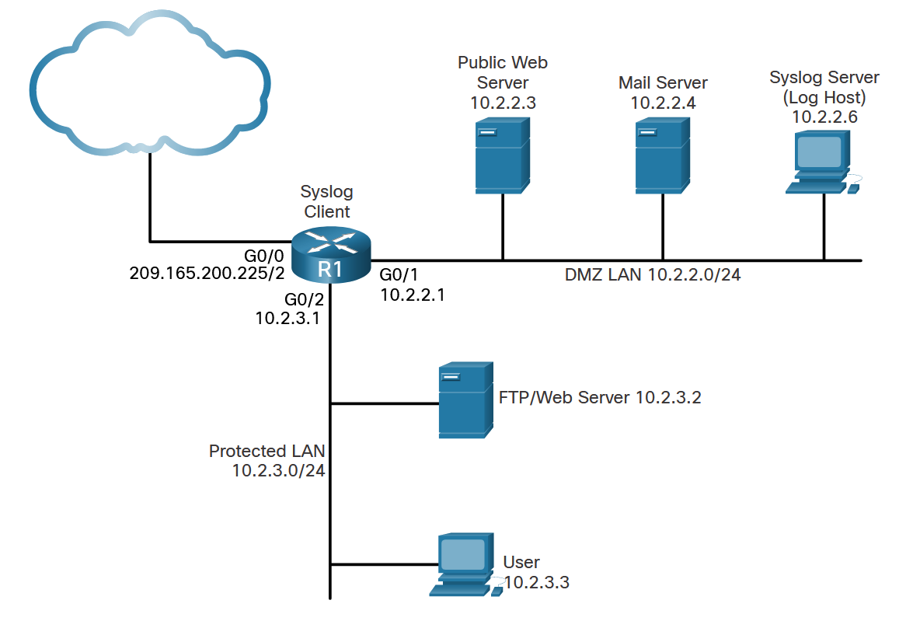
Network Security Using Syslog
Syslog Configuration
Configure system logging with the following steps:
Step 1. Set the destination logging host using the logging [host] command.
Step 2. (Optional) Set the log severity (trap) level using the logging trap command.
Step 3. (Optional) Set the source interface using the logging source-interface command.
Step 4. (Optional) Enable logging to all enabled destinations with the logging on command.
The figure shows the syslog reference topology.
Notes:
6: Device Monitoring and Management 6.5: Network Security Using Syslog 6.5.8: Configuring System Logging

Slide 84
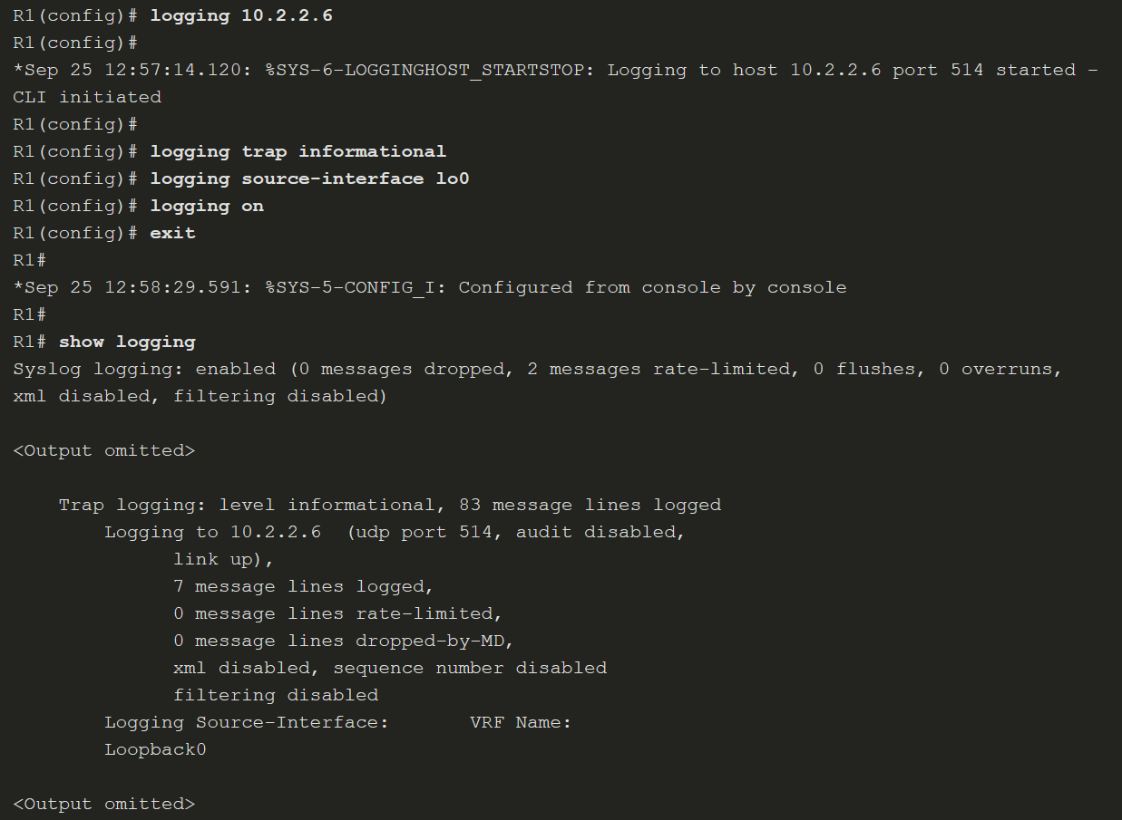
Network Security Using Syslog
Syslog Configuration (Cont.)
configure terminal
logging host 192.168.1.1
logging host 192.168.1.2
logging host 192.168.1.3
end
Notes:
6: Device Monitoring and Management 6.5: Network Security Using Syslog 6.5.8: Configuring System Logging

Slide 85
6.6 NTP Configuration
Notes:
6: Device Monitoring and Management 6.6: NTP Configuration

Slide 86
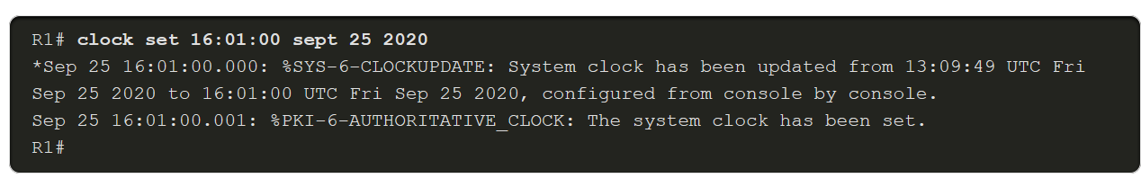
NTP Configuration
Time and Calendar Services
The software clock on a router or switch starts when the system boots. It is the primary source of time for the system. It is important to synchronize the time across all devices on the network because all aspects of managing, securing, troubleshooting, and planning networks require accurate timestamping.
The date and time settings on a router or switch can be manually configured, using the clock set command, as shown in the example.
clock timezone CET
clock summer-time CEST recurring 30 Sun Mar 2:00 26 Sun Oct 2:00 (pozor táto hodnota platí len pre rok 2025 – stále sa to mení …)
Time Zone & Clock Changes in Bratislava, Slovakia (timeanddate.com)
Notes:
6: Device Monitoring and Management 6.6: NTP Configuration 6.6.1: Time and Calendar Services

Slide 87
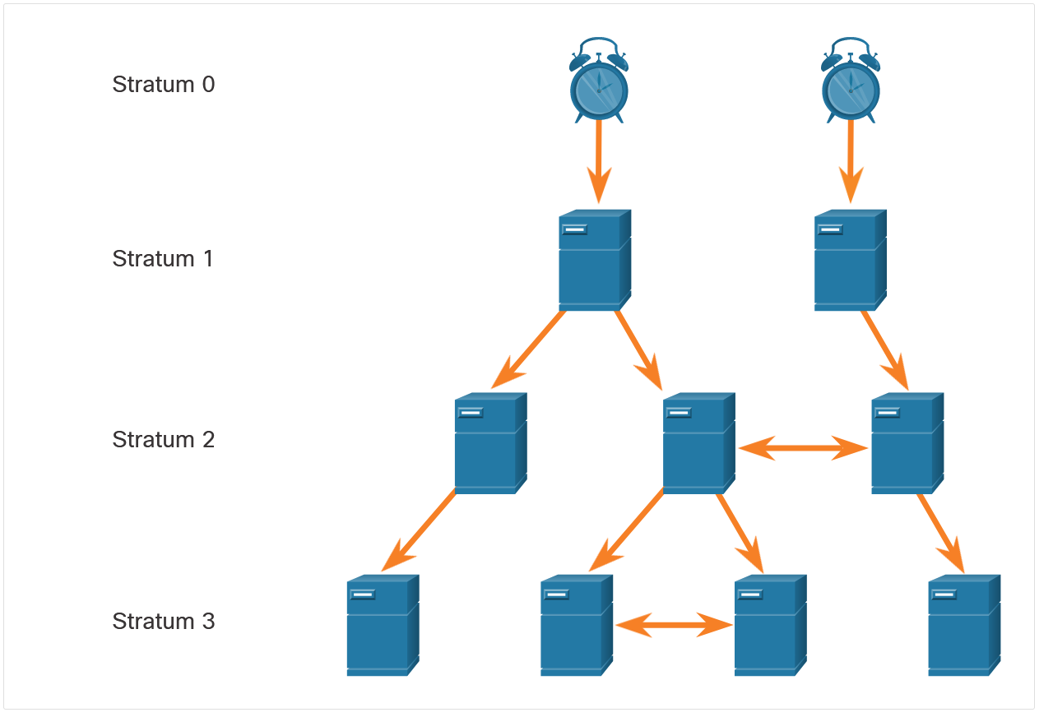
NTP Configuration
NTP Operation
NTP networks use a hierarchical system of time sources. Each level in this hierarchical system is called a stratum. The stratum level is defined as the number of hop counts from the authoritative source.
The sample network consists of four stratum levels who acquire their times as follows:
Stratum 1 server gets its time from the stratum 0 time source.
Stratum 2 server gets its time from the stratum 1 server.
Stratum 3 server gets its time from the stratum 2 server.
Notes:
6: Device Monitoring and Management 6.6: NTP Configuration 6.6.2: NTP Operation

Slide 88
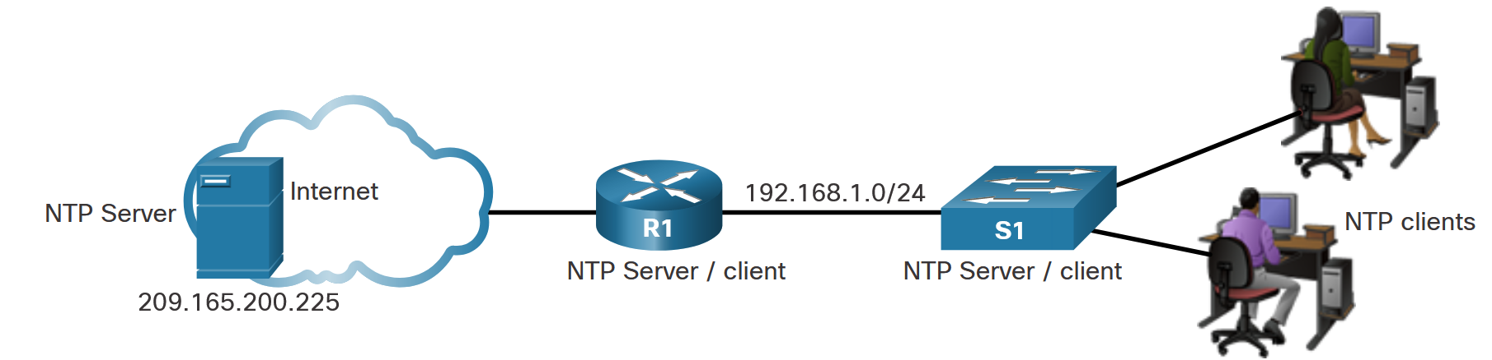
NTP Configuration
Configure and Verify NTP
The figure shows the topology used to demonstrate NTP configuration and verification
Notes:
6: Device Monitoring and Management 6.6: NTP Configuration 6.6.3: Configure and Verify NTP

Slide 89
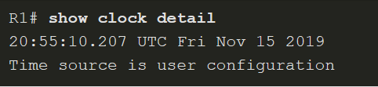
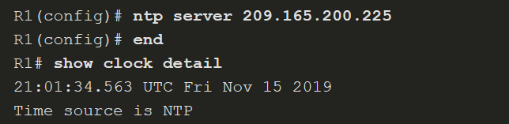
NTP Configuration
Configure and Verify NTP (Cont.)
Before NTP is configured on the network, the show clock detail command displays the time source is user configuration.
Use the ntp server ip-address command to configure a NTP server the device should use as a source. If the source is another Cisco device, it must be configured with the ntp master [stratum] command.
Notes:
6: Device Monitoring and Management 6.6: NTP Configuration 6.6.3: Configure and Verify NTP

Slide 90
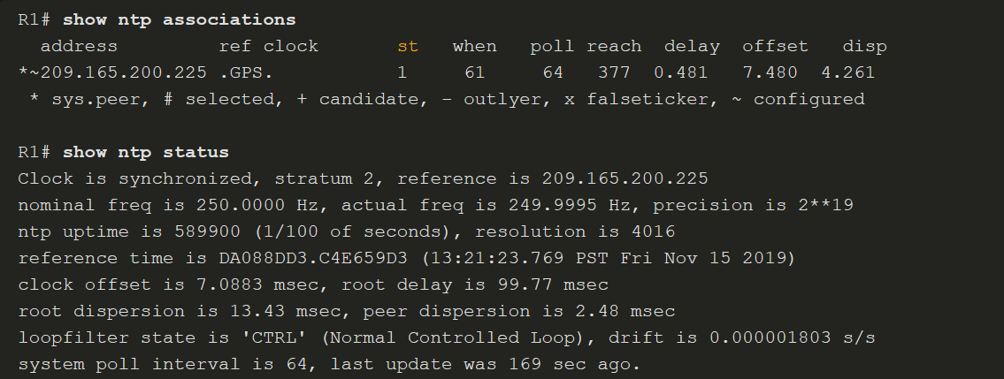
NTP Configuration
Configure and Verify NTP (Cont.)
Use the show ntp associations and show ntp status commands to verify the device is synchronized with the NTP server.
Notes:
6: Device Monitoring and Management 6.6: NTP Configuration 6.6.3: Configure and Verify NTP
6.6.4: Packet Tracer - Configure and Verify NTP

Slide 91
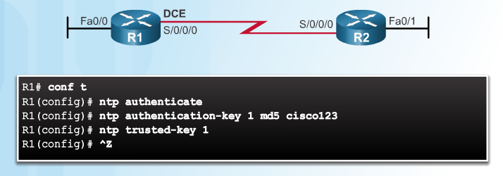
NTP Authentication
Notes:
2.3.5.3 NTP Authentication
Syntax Checker: Configure NTP Authentication on R1

Slide 92
6.7 SNMP Configuration
Notes:
6: Device Monitoring and Management 6.7: SNMP Configuration

Slide 93
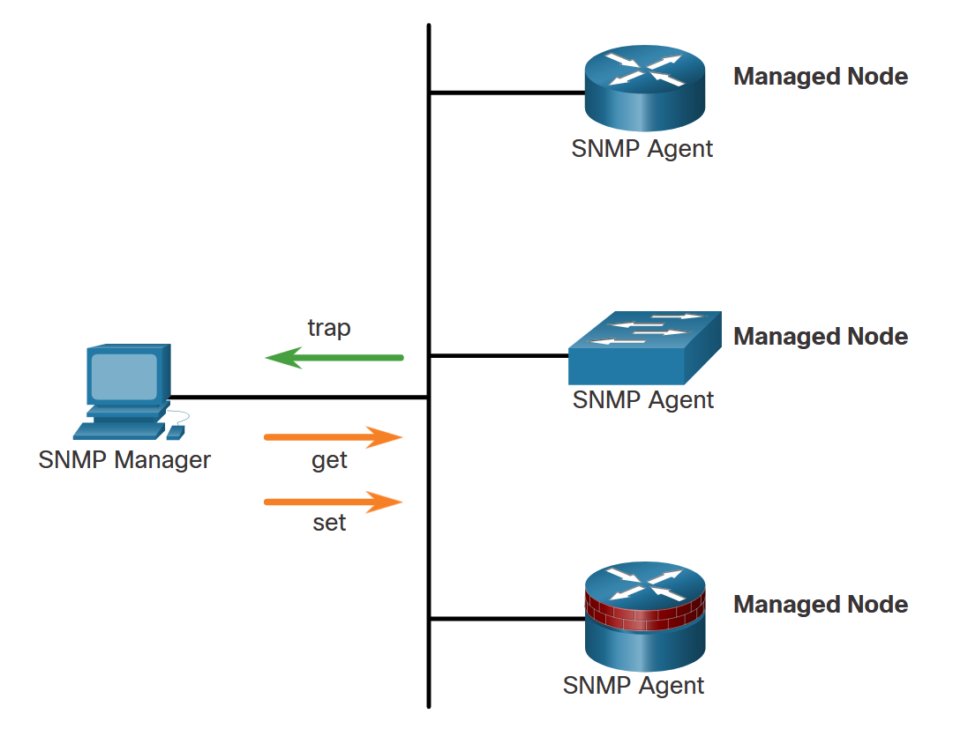
SNMP Configuration
Introduction to SNMP
SNMP is an application layer protocol that provides a message format for communication between managers and agents.
The SNMP system consists of three elements:
SNMP manager
SNMP agents (managed node)
Management Information Base (MIB)
To configure SNMP on a networking device, it is first necessary to define the relationship between the manager and the agent.
The SNMP manager is part of a network management system (NMS). The SNMP manager runs SNMP management software.
As shown in the figure, the SNMP manager can collect information from an SNMP agent by using the “get” action. It can change configurations on an agent by using the “set” action. In addition, SNMP agents can forward information directly to a network manager by using “traps”.
Notes:
6: Device Monitoring and Management 6.7: SNMP Configuration 6.7.1: Introduction to SNMP

Slide 94
SNMP Configuration
SNMP Operation
There are two primary SNMP manager requests:
get request - Used by the NMS to query the device for data.
set request - Used by the NMS to change configuration variables in the agent device. A set request can also initiate actions within a device. For example, a set request can cause a router to reboot, send a configuration file, or receive a configuration file.
The SNMP manager uses the get and set actions to perform the operations described in the table.
get-request | Retrieves a value from a specific variable.
get-next-request | Retrieves a value from a variable within a table; the SNMP manager does not need to know the exact variable name. A sequential search is performed to find the needed variable from within a table.
get-bulk-request | Retrieves large blocks of data, such as multiple rows in a table, that would otherwise require the transmission of many small blocks of data. (Only works with SNMPv2 or later.)
get-response | Replies to a get-request, get-next-request, and set-request sent by an NMS.
set-request | Stores a value in a specific variable.
Notes:
6: Device Monitoring and Management 6.7: SNMP Configuration 6.7.2: SNMP Operation

Slide 95
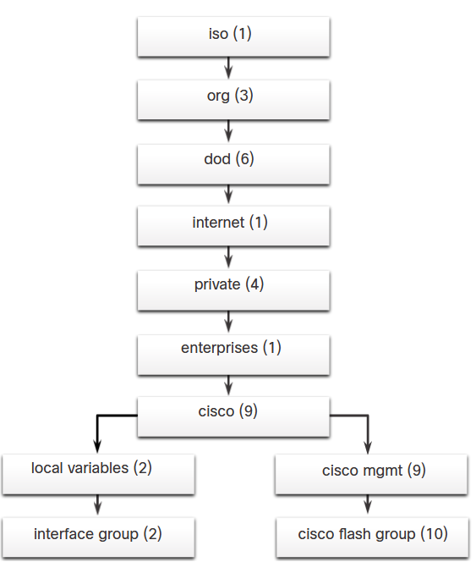
SNMP Configuration
Management Information Base (MIB)
The MIB organizes variables hierarchically. MIB variables enable the management software to monitor and control the network device.
Formally, the MIB defines each variable as an object ID (OID). OIDs uniquely identify managed objects in the MIB hierarchy. The MIB organizes the OIDs based on RFC standards into a hierarchy of OIDs, usually shown as a tree.
The figure shows portions of the MIB structure defined by Cisco. Note how the OID can be described in words or numbers to help locate a particular variable in the tree. OIDs belonging to Cisco, are numbered as follows: .iso (1).org (3).dod (6).internet (1).private (4).enterprises (1).cisco (9). Therefore, the OID is 1.3.6.1.4.1.9.
Notes:
6: Device Monitoring and Management 6.7: SNMP Configuration 6.7.3: Management Information Base (MIB)

Slide 96
SNMP Configuration
SNMP Versions
Here are several versions of SNMP:
SNMPv1 - This is the Simple Network Management Protocol, a Full Internet Standard, that is defined in RFC 1157.
SNMPv2c - This is defined in RFCs 1901 to 1908. It uses a community-string-based Administrative Framework.
SNMPv3 - This is an interoperable standards-based protocol originally defined in RFCs 2273 to 2275. It provides secure access to devices by authenticating and encrypting packets over the network. It includes these security features: message integrity to ensure that a packet was not tampered with in transit, authentication to determine that the message is from a valid source, and encryption to prevent the contents of a message from being read by an unauthorized source.
All versions use SNMP managers, agents, and MIBs. Cisco IOS software supports the above three versions. Both SNMPv1 and SNMPv2c use a community-based form of security. The community of managers that is able to access the MIB of the agent is defined by a community string. SNMPv3 provides for both security models and security levels.
Notes:
6: Device Monitoring and Management 6.7: SNMP Configuration 6.7.4: SNMP Versions

Slide 97
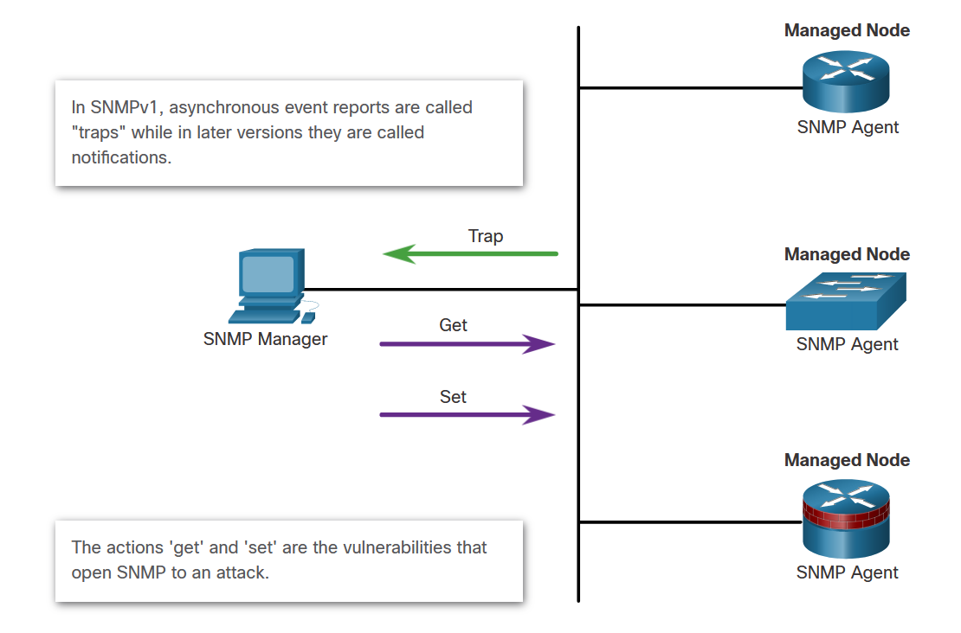
SNMP Configuration
SNMP Vulnerabilities
In any network topology, at least one manager node should run SNMP management software. Network devices that can be managed, such as switches, routers, servers, and workstations, are equipped with the SNMP agent software module.
SNMP is vulnerable to attack precisely because SNMP agents can be polled with get requests and accept configuration changes with set requests, as shown in the figure.
Notes:
6: Device Monitoring and Management 6.7: SNMP Configuration 6.7.5: SNMP Vulnerabilities

Slide 98
SNMP Configuration
SNMPv3
SNMPv3 provides three security features:
Message integrity and authentication - Ensures that a packet has not been tampered with in transit and is from a valid source.
Encryption - Scrambles the contents of a packet to prevent it from being seen by an unauthorized source.
Access control - Restricts each principal to certain actions on specific portions of data.
Notes:
6: Device Monitoring and Management 6.7: SNMP Configuration 6.7.6: SNMPv3

Slide 99
SNMP Configuration
SNMPv3 Security Configuration
SNMPv3 can be secured with only a few commands:
Step 1. Configure an ACL that will permit access to authorized SNMP managers.
Step 2. Configure an SNMP view with the snmp-server view command to identify the MIB OIDs that the SNMP manager will be able to read. Configuring a view is required to limit SNMP messages to read-only access.
Step 3. Configure SNMP group features with the snmp-server group command:
Configure a name for the group.
Set the SNMP version to 3 with the v3 keyword.
Require authentication and encryption with the priv keyword.
Associate a view to the group and give it read only access with the read command.
Specify the ACL configured in Step 1.
Notes:
6: Device Monitoring and Management 6.7: SNMP Configuration 6.7.7: Configuring SNMPv3 Security

Slide 100
SNMP Configuration
SNMPv3 Security Configuration (Cont.)
SNMPv3 can be secured with only a few commands:
Step 4. Configure SNMP group user features with the snmp-server user command:
Configure a username and associate the user with the group name configured in Step 3.
Set the SNMP version to 3 with the v3 keyword.
Set the authentication type to either md5 or sha and configure an authentication password. SHA is preferred and should be supported by the SNMP management software.
Require encryption with the priv keyword and configure an encryption password.
Notes:
6: Device Monitoring and Management 6.7: SNMP Configuration 6.7.7: Configuring SNMPv3 Security

Slide 101
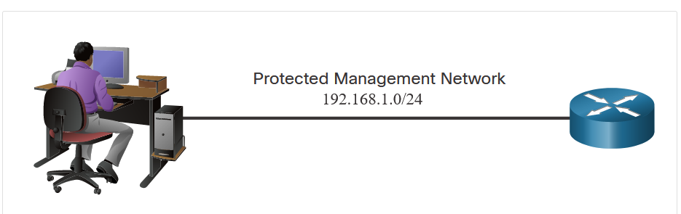
SNMP Configuration
SNMPv3 Security Configuration Example
The figure shows an example configuration for securing SNMPv3.
Step 1. A standard ACL is named PERMIT-ADMIN and is configured to permit only the 192.168.1.0/24 network.
Step 2. An SNMP view is named SNMP-RO and is configured to include the entire iso tree from the MIB.
Step 3. An SNMP group is configured with the name ADMIN, SNMPv3, and access for those allowed with the PERMIT-ADMIN ACL.
Step 4. An SNMP user, BOB, is configured as a member of the group ADMIN using SNMPv3, with SHA authentication, AES 256 encryption, and the encryption password.
Notes:
6: Device Monitoring and Management 6.7: SNMP Configuration 6.7.8: SNMPv3 Security Configuration Example
6.7.9: Syntax Checker – SNMP3 Security Configuration Example

Slide 102
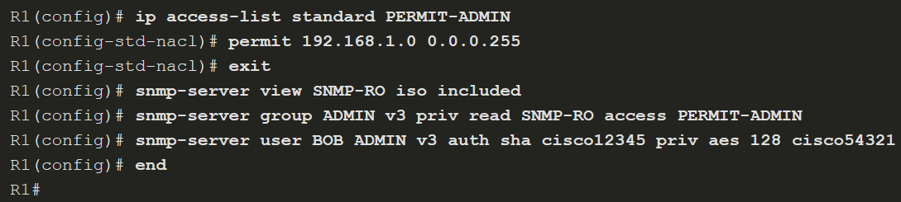
SNMP Configuration
SNMPv3 Verification
Notes:
6: Device Monitoring and Management 6.7: SNMP Configuration 6.7.10: SNMP3 Verification

Slide 103

SNMP Configuration
SNMPv3 Verification (Cont.)
Verify most of the SNMPv3 security configuration by viewing the running configuration, as shown in in the figure. Notice that the snmp-server user configuration is hidden. Use the show snmp user command to view the user information.
Notes:
6: Device Monitoring and Management 6.7: SNMP Configuration 6.7.10: SNMPv3 Verification

Slide 104

SNMP Configuration
SNMPv3 Verification (Cont.)
Verify that the SNMP manager can send get requests to R1 by using an SNMP management tool, such as the ManageEngine’s free SNMP MIB Browser. Configure the tool with the user details. When a user is configured, use the SNMP management tool’s features to test that the configured user can access the SNMP agent.
Notes:
6: Device Monitoring and Management 6.7: SNMP Configuration 6.7.10: SNMPv3 Verification

Slide 105

SNMP Configuration
SNMPv3 Verification (Cont.)
In the figure below, the network administrator entered the OID for the IP addressing table. The get request returned all the addressing information for R1. The network administrator authenticated with the appropriate credentials.
Notes:
6: Device Monitoring and Management 6.7: SNMP Configuration 6.7.10: Verifying the SNMPv3 Configuration

